Slide 1


A Multi-Envelope s-coordinate system
for numerical ocean modelling:
idealised experiments and
realistic applications
Diego Bruciaferri
diego.bruciaferri@metoffice.gov.uk
29th of June 2022

Slide 2
OUTLINE
Background & motivations:
why do we care so much about vertical coordinates in ocean (i.e., GFD)
numerical modelling?
Our idea:
the Multi-Envelope (ME) s-coordinate system
Testing the idea:
idealised experiments
Applying our method in realistic regional ocean models:
The Black Sea test case
The Met Office AMM7 configuration
The Met Office GULF18 configuration (paper in review for GMD, not shown here)
Developing the idea further:
localised ME s-coordinates for global ocean models

Slide 3
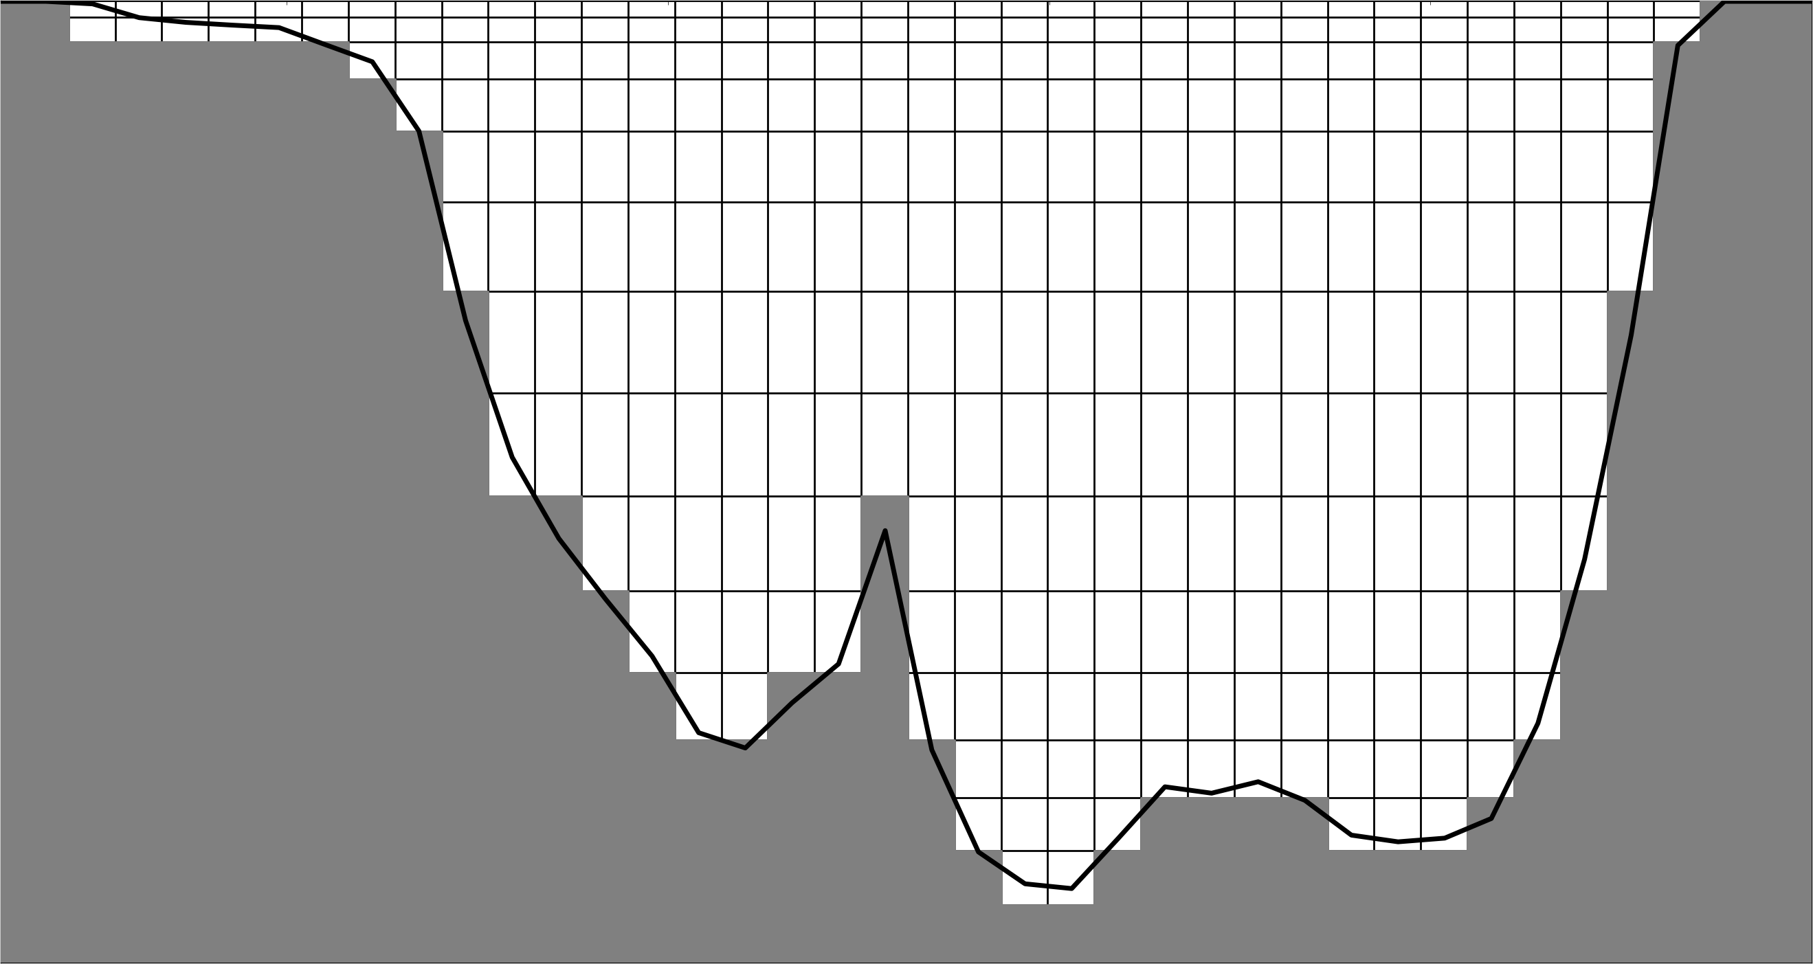
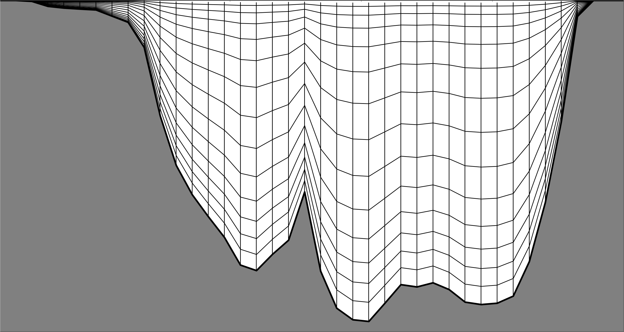
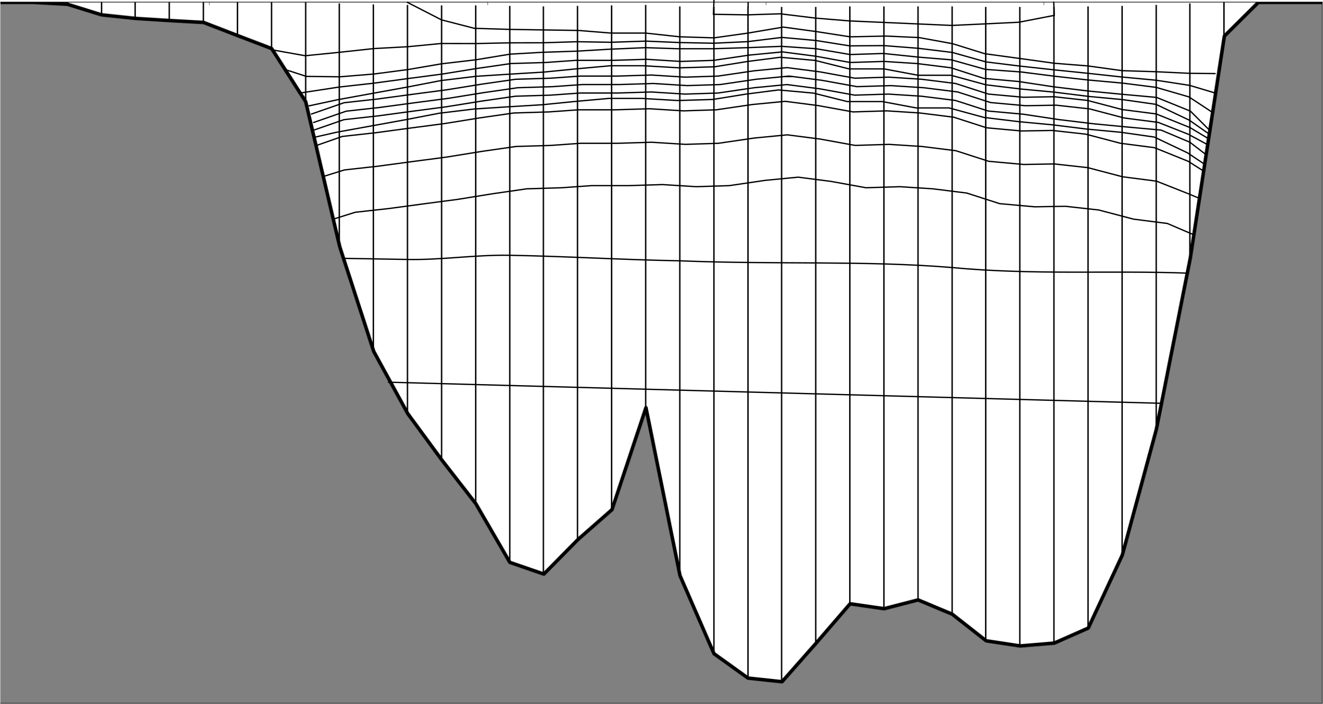
INTRODUCTION
Currently, three main vertical coordinates are used in ocean modelling:
z-geopotential
s-terrain-following
ρ-isopycnal

Slide 4
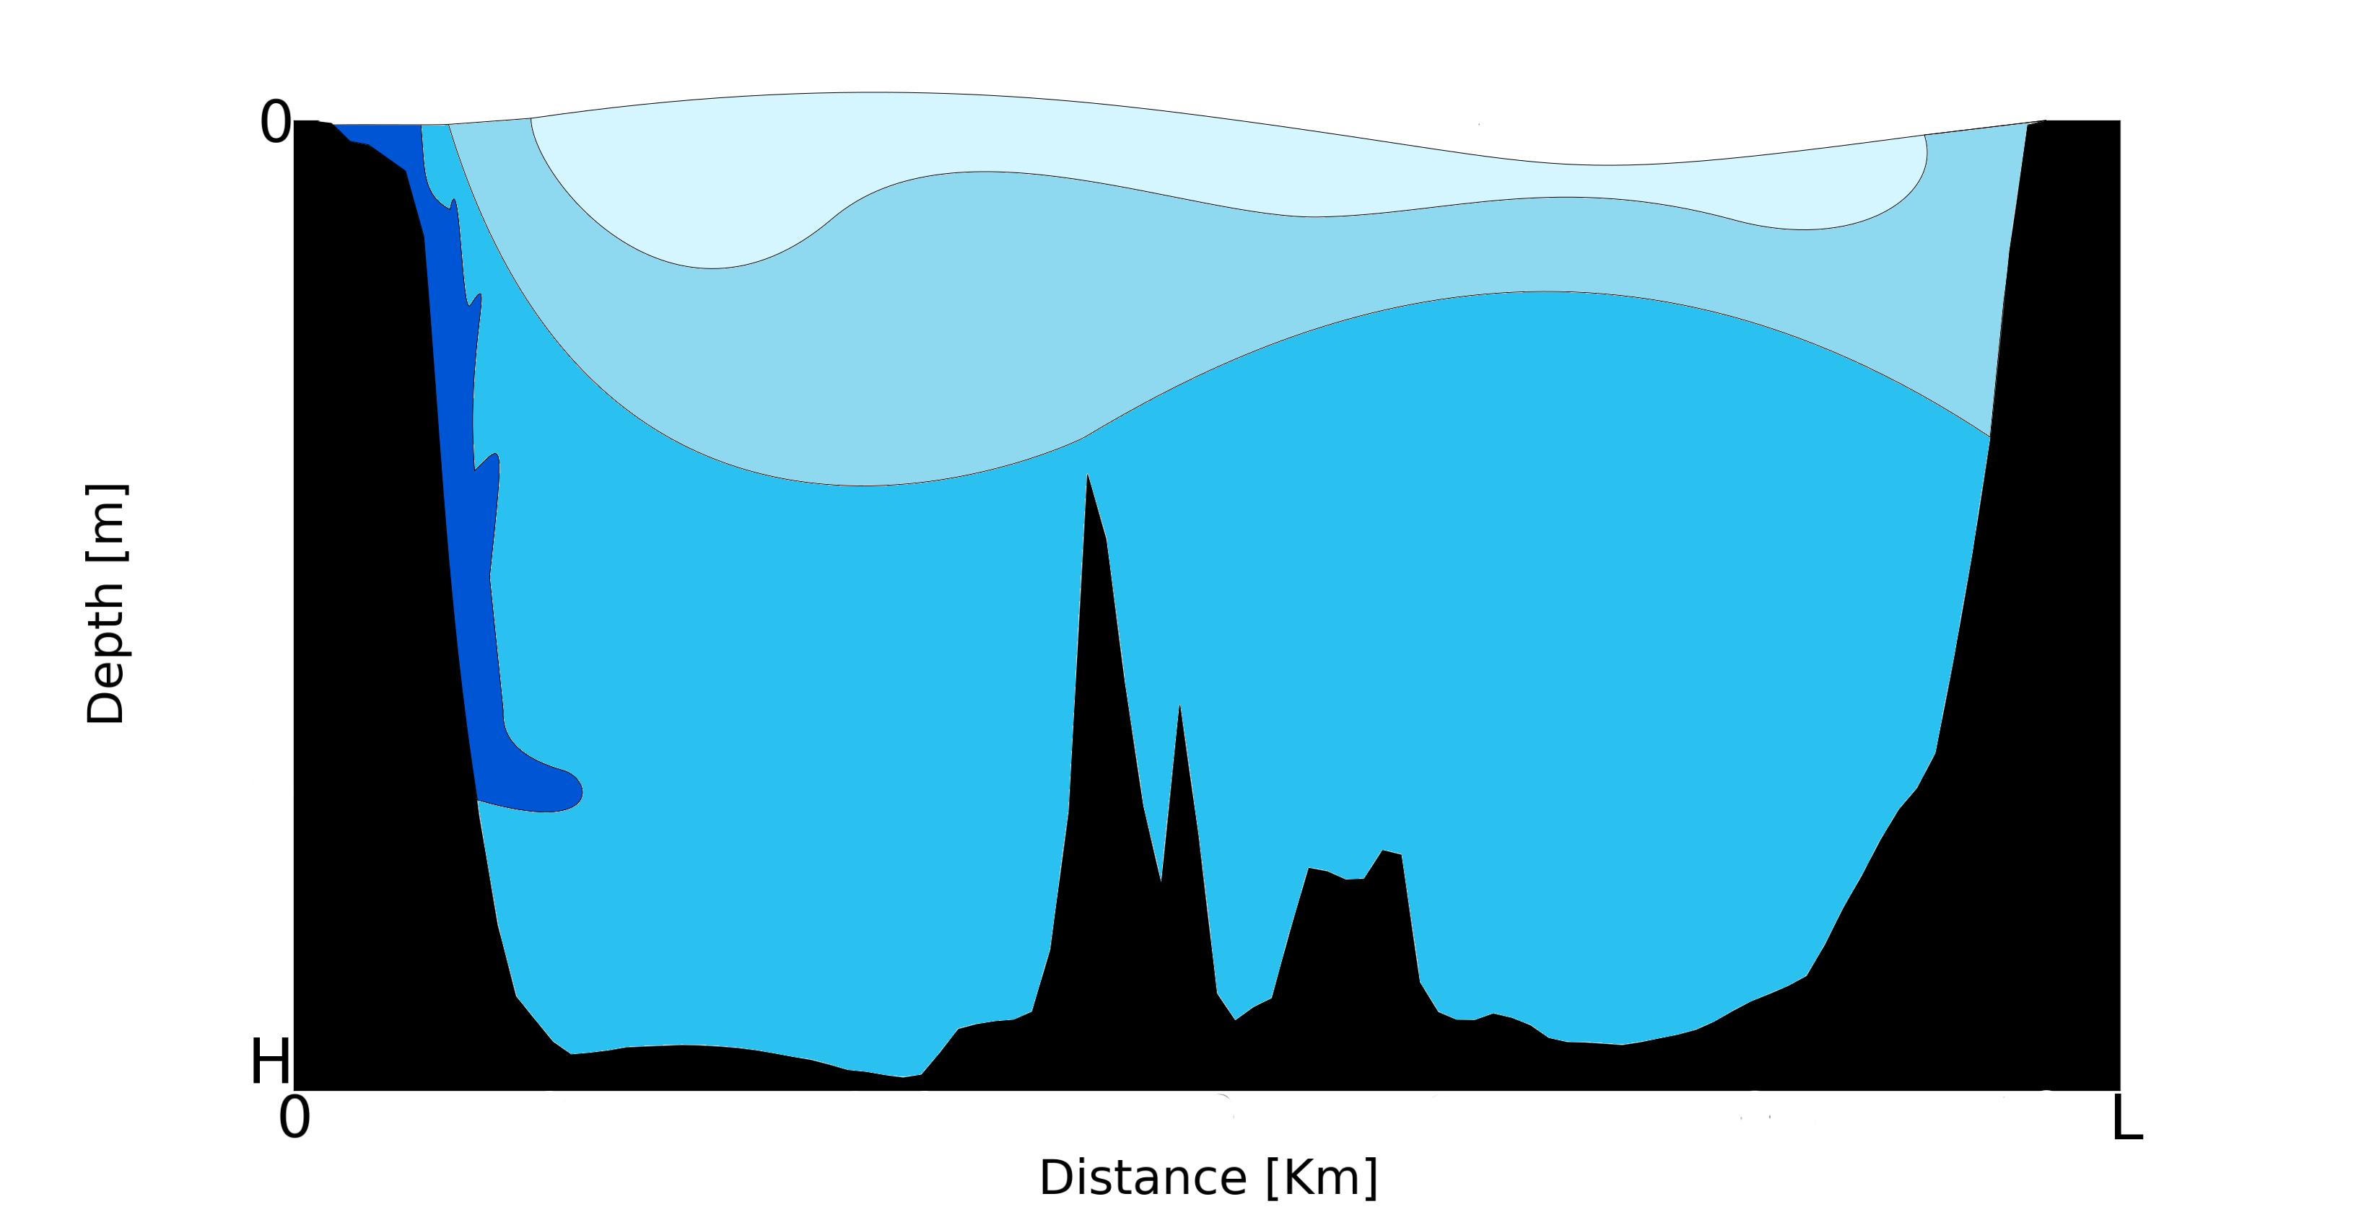
INTRODUCTION
BUT all of them present limitations [Griffies et al. 2000]

Slide 5
INTRODUCTION
BUT all of them present limitations [Griffies et al. 2000]
Upper Mixed Layer dynamics:
z-geopotential
s-terrain-following
ρ-isopycnal

Slide 6
INTRODUCTION
BUT all of them present limitations [Griffies et al. 2000]
Upper Mixed Layer dynamics:
z-geopotential
s-terrain-following
ρ-isopycnal
Bottom Boundary Layer dynamics – Density
driven currents over steep topography:
z-geopotential
s-terrain-following
ρ-isopycnal

Slide 7
INTRODUCTION
BUT all of them present limitations [Griffies et al. 2000]
Upper Mixed Layer dynamics:
z-geopotential
s-terrain-following
ρ-isopycnal
Bottom Boundary Layer dynamics – Density
driven currents over steep topography:
z-geopotential
s-terrain-following
ρ-isopycnal
Horizontal Pressure Gradients:
z-geopotential
s-terrain-following
ρ-isopycnal

Slide 8
INTRODUCTION
BUT all of them present limitations [Griffies et al. 2000]
Upper Mixed Layer dynamics:
z-geopotential
s-terrain-following
ρ-isopycnal
Isoneutral tracer transport
in the ocean interior:
z-geopotential
s-terrain-following
ρ-isopycnal
Bottom Boundary Layer dynamics – Density
driven currents over steep topography:
z-geopotential
s-terrain-following
ρ-isopycnal
Horizontal Pressure Gradients:
z-geopotential
s-terrain-following
ρ-isopycnal

Slide 9
INTRODUCTION
RESEARCH AIM
Develop a vertical discretization scheme which minimise the disadvantages of those existing vertical coordinate systems but combine their advantages

Slide 10
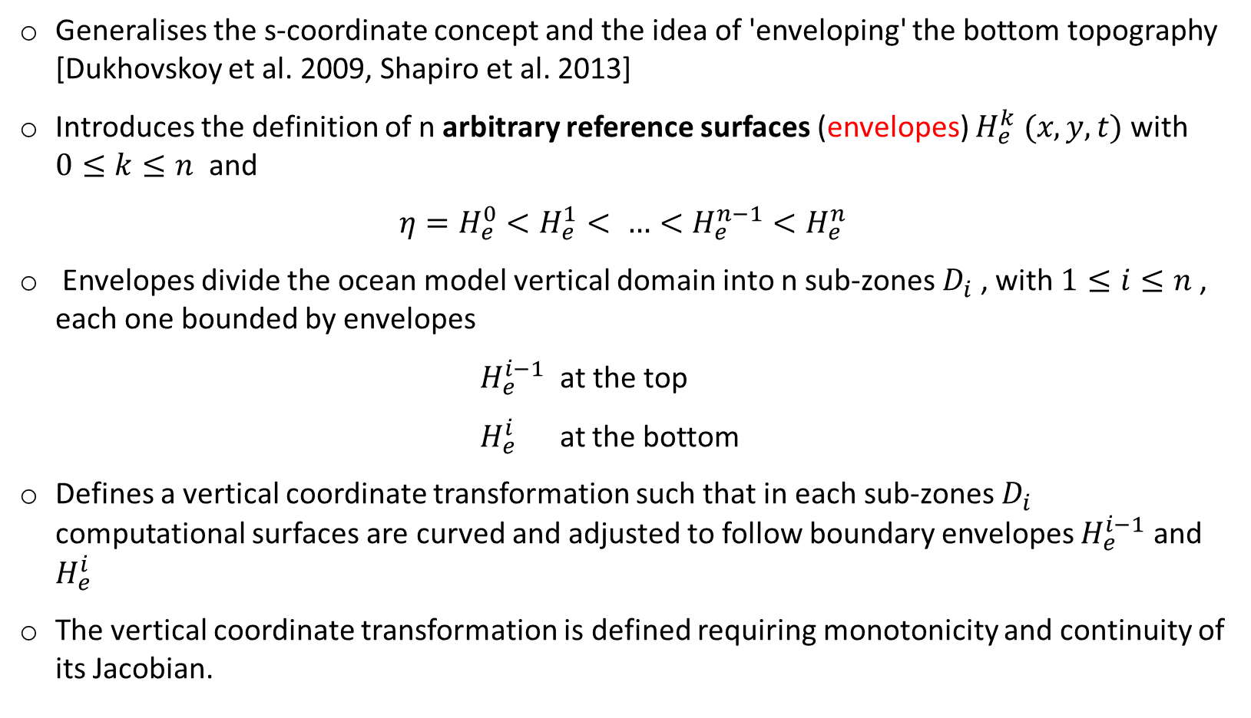
THE MULTI-ENVELOPE s-coordinate
Generalises the s-coordinate concept and the idea of 'enveloping' the bottom topography [Dukhovskoy et al. 2009, Shapiro et al. 2013]
Introduces the definition of n arbitrary reference surfaces (envelopes) $H_{e}^{k} (x,y,t)$ with $0≤k≤n$ and
$$η=H_{e}^{0}<H_{e}^{1}< …<H_{e}^{n−1}<H_{e}^{n}$$
Envelopes divide the ocean model vertical domain into n sub-zones $D_{i}$ , with $1≤i≤n$ , each one bounded by envelopes
$H_{e}^{i−1}$ at the top
$H_{e}^{i}$ at the bottom
Defines a vertical coordinate transformation such that in each sub-zones $D_{i}$ computational surfaces are curved and adjusted to follow boundary envelopes $H_{e}^{i−1}$ and $H_{e}^{i}$
The vertical coordinate transformation is defined requiring monotonicity and continuity of its Jacobian.

Slide 11
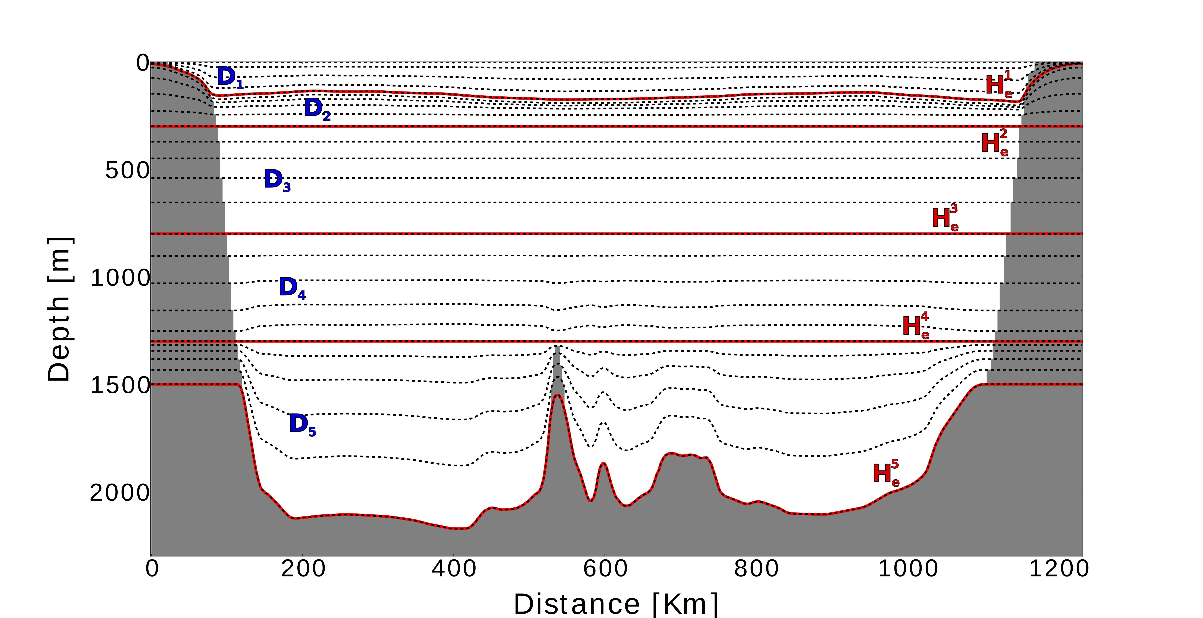
THE MULTI-ENVELOPE s-coordinate
Envelopes are arbitrarily chosen surfaces: model levels can be optimised for the prevailing physics
How does it look like? Example of MEs design with five envelopes

Slide 12
THE MULTI-ENVELOPE s-coordinate
Envelopes are arbitrarily chosen surfaces: model levels can be optimised for the prevailing physics
How does it look like? Example of MEs design with five envelopes
Model levels follow a smooth version of the actual topography up to 1500 m:
Reduced HPGE
Realistic simulations of dense water overflows

Slide 13
THE MULTI-ENVELOPE s-coordinate
Envelopes are arbitrarily chosen surfaces: model levels can be optimised for the prevailing physics
How does it look like? Example of MEs design with five envelopes
Model levels follow geopotential surfaces
NO HPGE
Model levels follow a smooth version of the actual topography up to 1500 m:
Reduced HPGE
Realistic simulations of dense water overflows

Slide 14
THE MULTI-ENVELOPE s-coordinate
Envelopes are arbitrarily chosen surfaces: model levels can be optimised for the prevailing physics
How does it look like? Example of MEs design with five envelopes
Model levels follow geopotential surfaces
NO HPGE
Model levels follow a smooth version of the actual topography up to 1500 m:
Reduced HPGE
Realistic simulations of dense water overflows
Transition zones

Slide 15
THE MULTI-ENVELOPE s-coordinate
Envelopes are arbitrarily chosen surfaces: model levels can be optimised for the prevailing physics
How does it look like? Example of MEs design with five envelopes
Model levels mimic the main pycnocline in open ocean areas but they follow a smooth version of the actual topography in coastal regions:
Reduced HPGE
Realistic simulations of cascadings on the shelf
Improved representation of isopycnal transport in the ocean interior
Model levels follow geopotential surfaces
NO HPGE
Model levels follow a smooth version of the actual topography up to 1500 m:
Reduced HPGE
Realistic simulations of dense water overflows
Transition zones

Slide 16
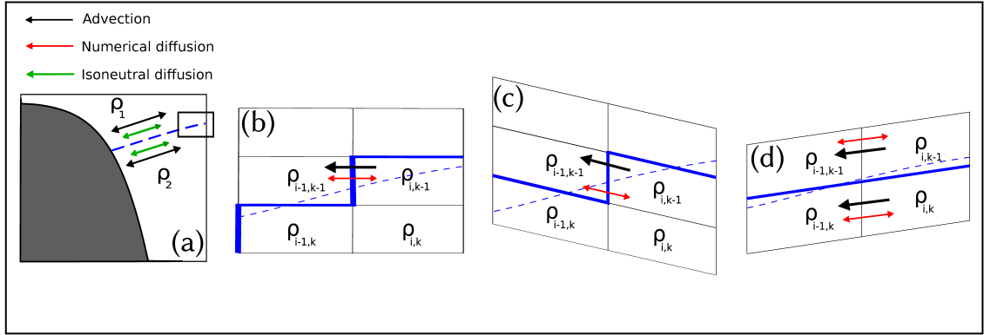
THE MULTI-ENVELOPE s-coordinate
Model levels mimicking the main pycnocline in open ocean areas can improve the representation of the isopycnal transport in the ocean interior
z-model
s-model
MEs-model
Idealised two-layer immiscible ocean:
tracer adv. & diff.
only along the isopycnal surface
Angle between isopycnals and comput. surfaces is large: strong ‘along-model-levels’ numer. diff. causes spurious mixing across the pycnocline
Model levels nearly parallel to isopycnals: numer. diff. mainly along isopycnals, spurious diapycnal mixing is reduced

Slide 17
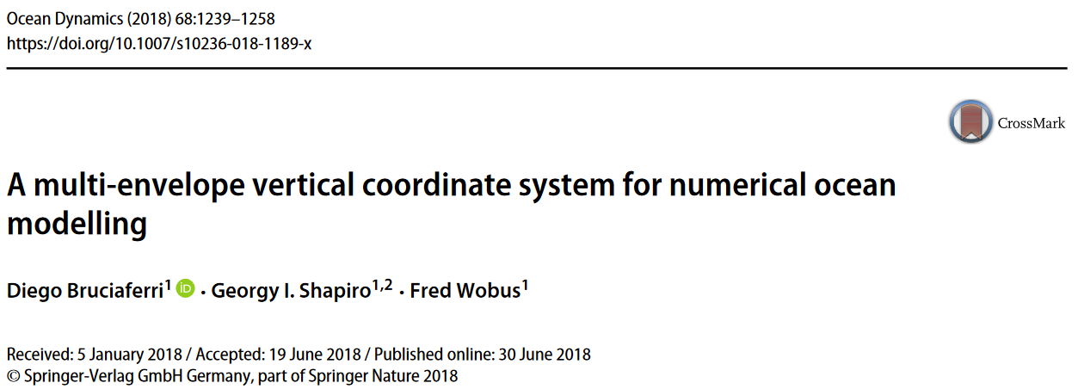
IDEALISED EXPERIMENTS
Notes:
We test the skills of the multi-enveIope system in idealised and realistic experiments.
The results of the idealised study have been published in this paper so that you can find all the details there.

Slide 18
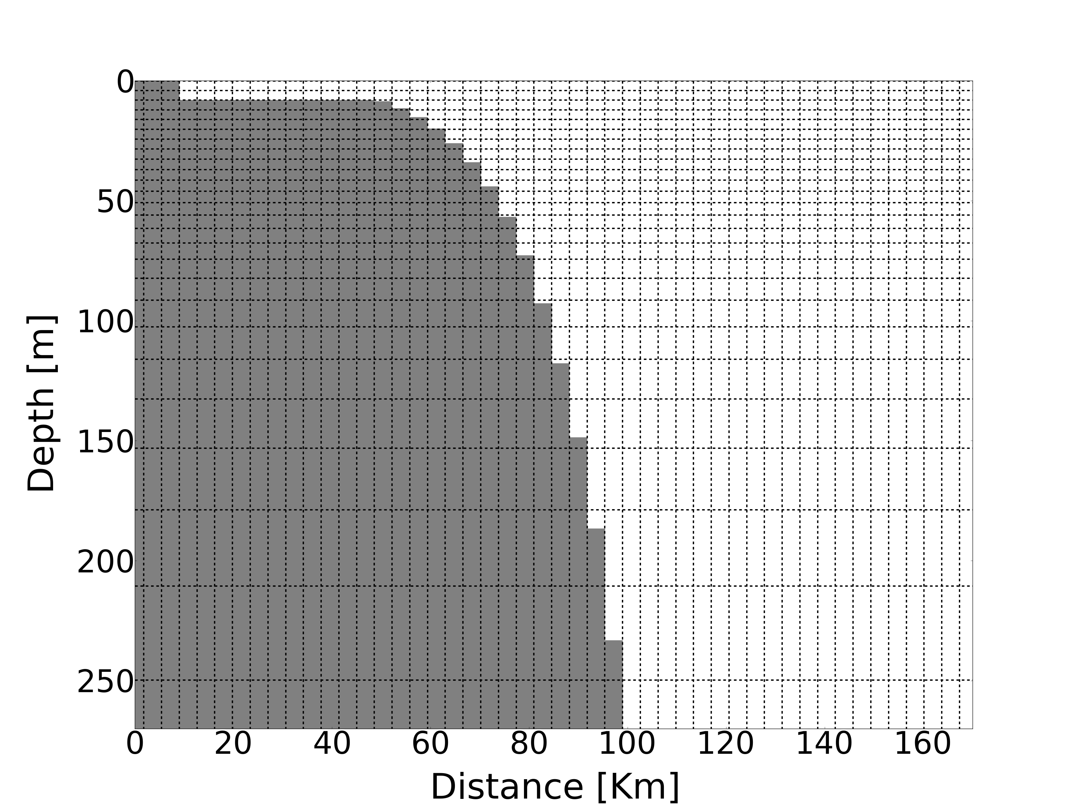
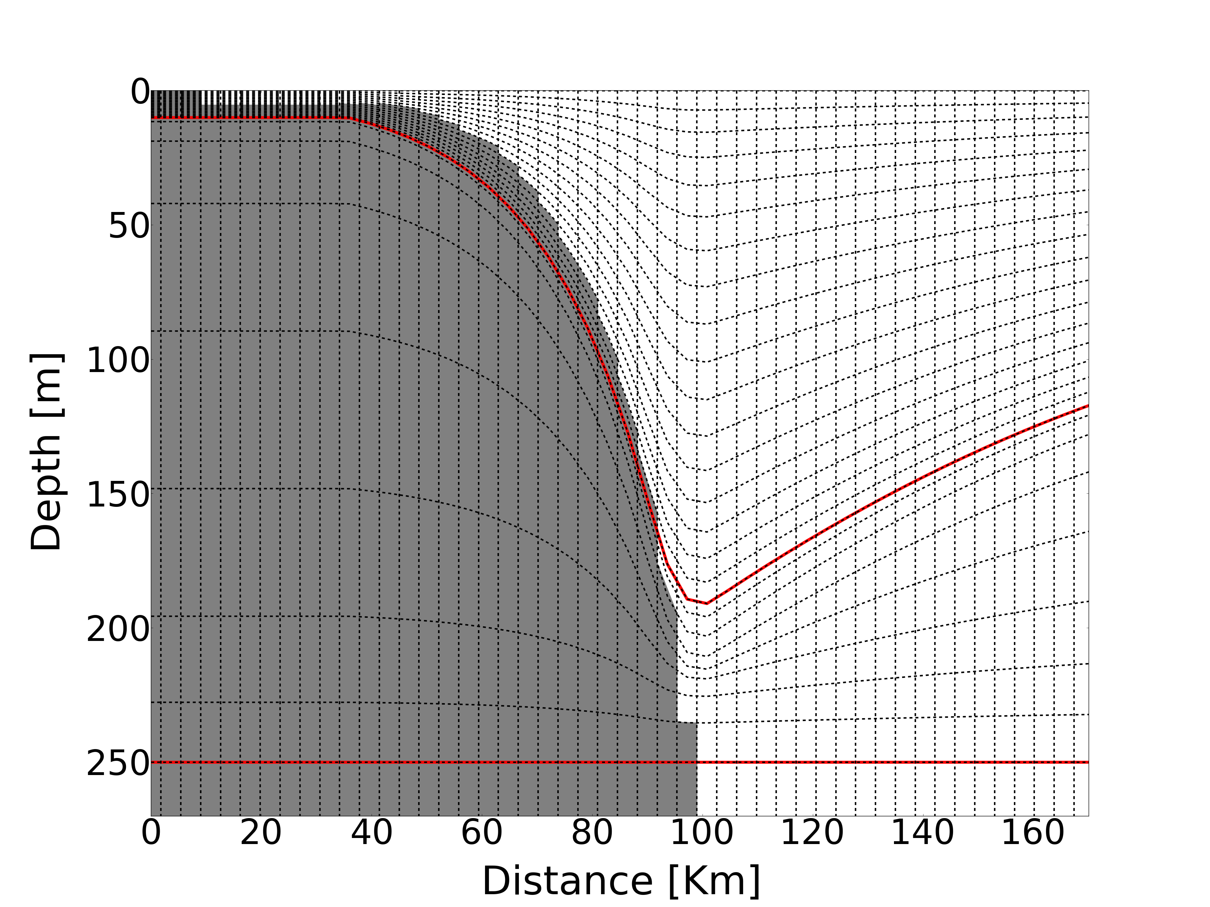
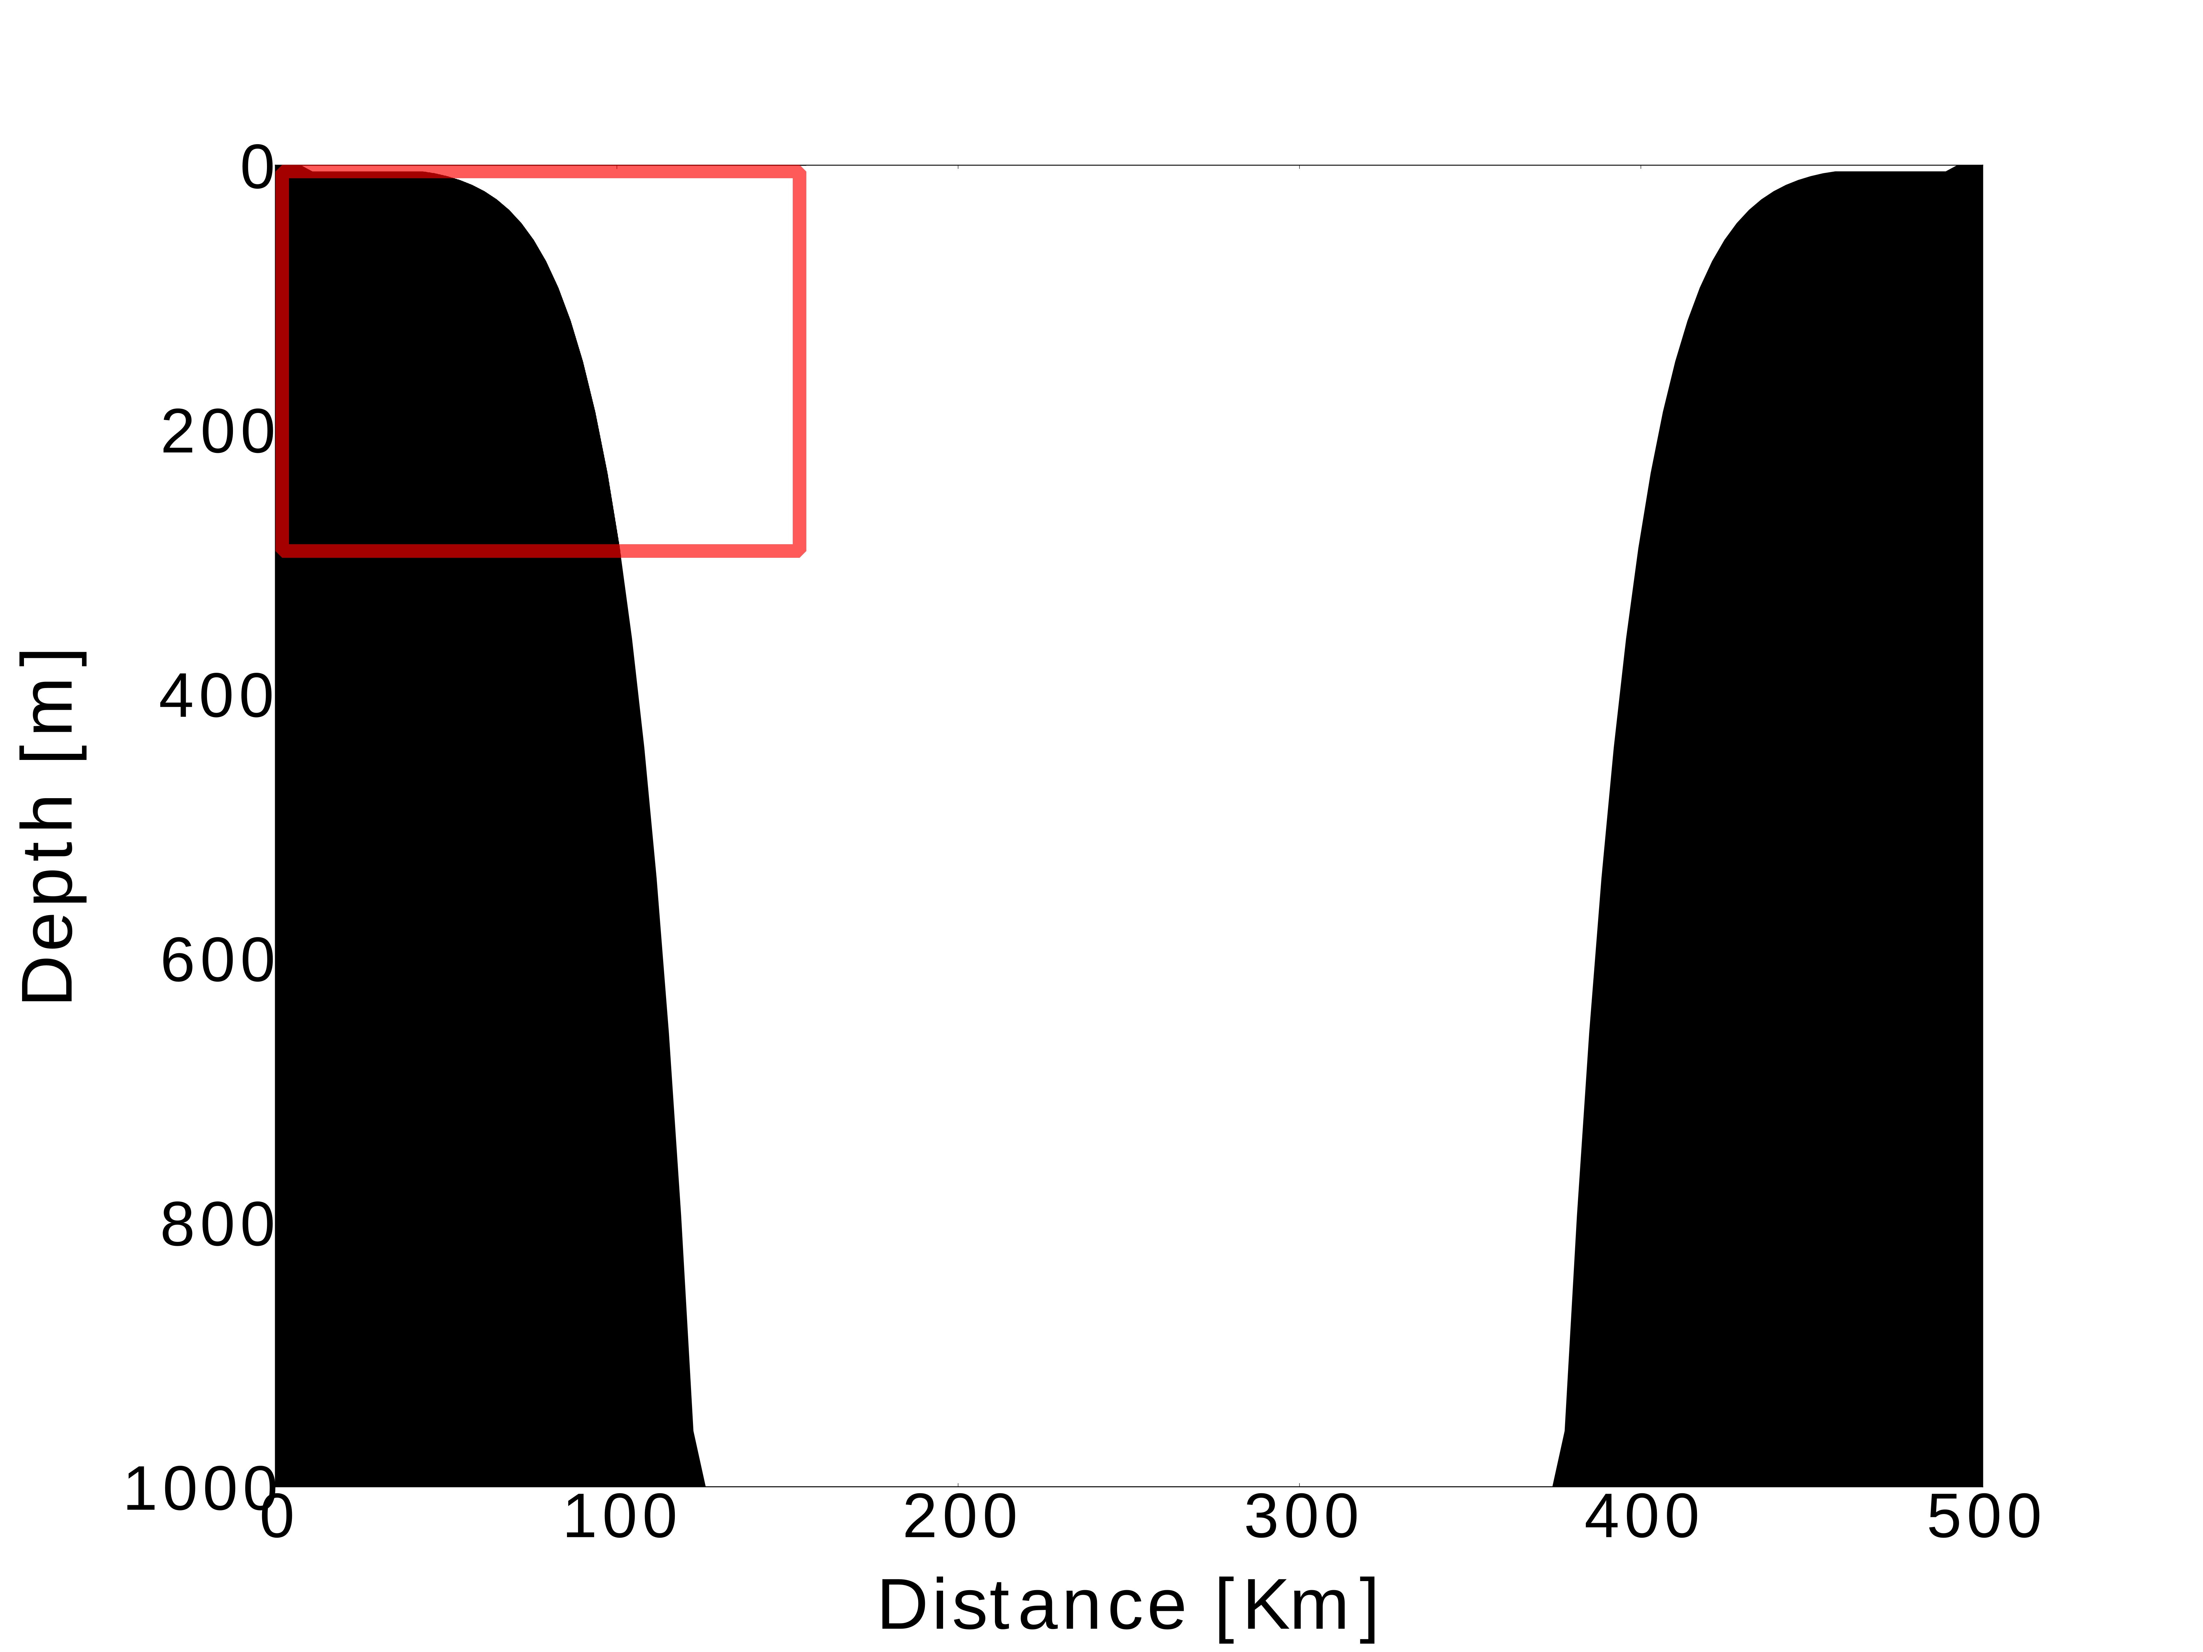
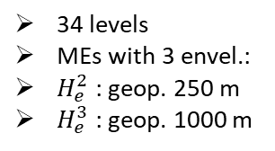
IDEALISED EXPERIMENTS – SET UP
zps-34
Two Idealised process-oriented numerical experiments
The Multi-Envelope s-coordinate (MEs) vs the z-level with partial steps (zps) scheme
MEs is introduced in NEMO v3.6
34 levels
Standard NEMO-3.6 z with partial steps scheme
OCEAN INTERIOR
Dome-shaped levels: mimic thermocline in a sea with cyclonic circulation
COASTAL AREAS
Levels follows a smooth version of the actual bathymetry
Axisymmetric bowl-shape ocean basin:
Diameter = 500 km
Max depth = 1 km
Horizontal grid:
140 x 140
dx = dy ≈ 3.5 km
34 levels
MEs with 3 envel.:
$H_{e}^{2}$ : geop. 250 m
$H_{e}^{3}$ : geop. 1000 m
MEs-34

Slide 19
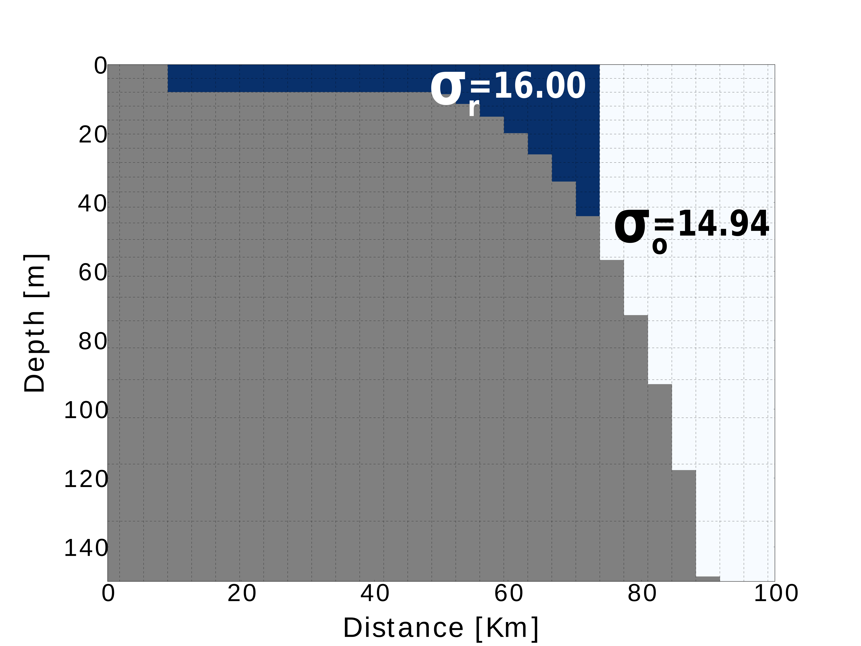
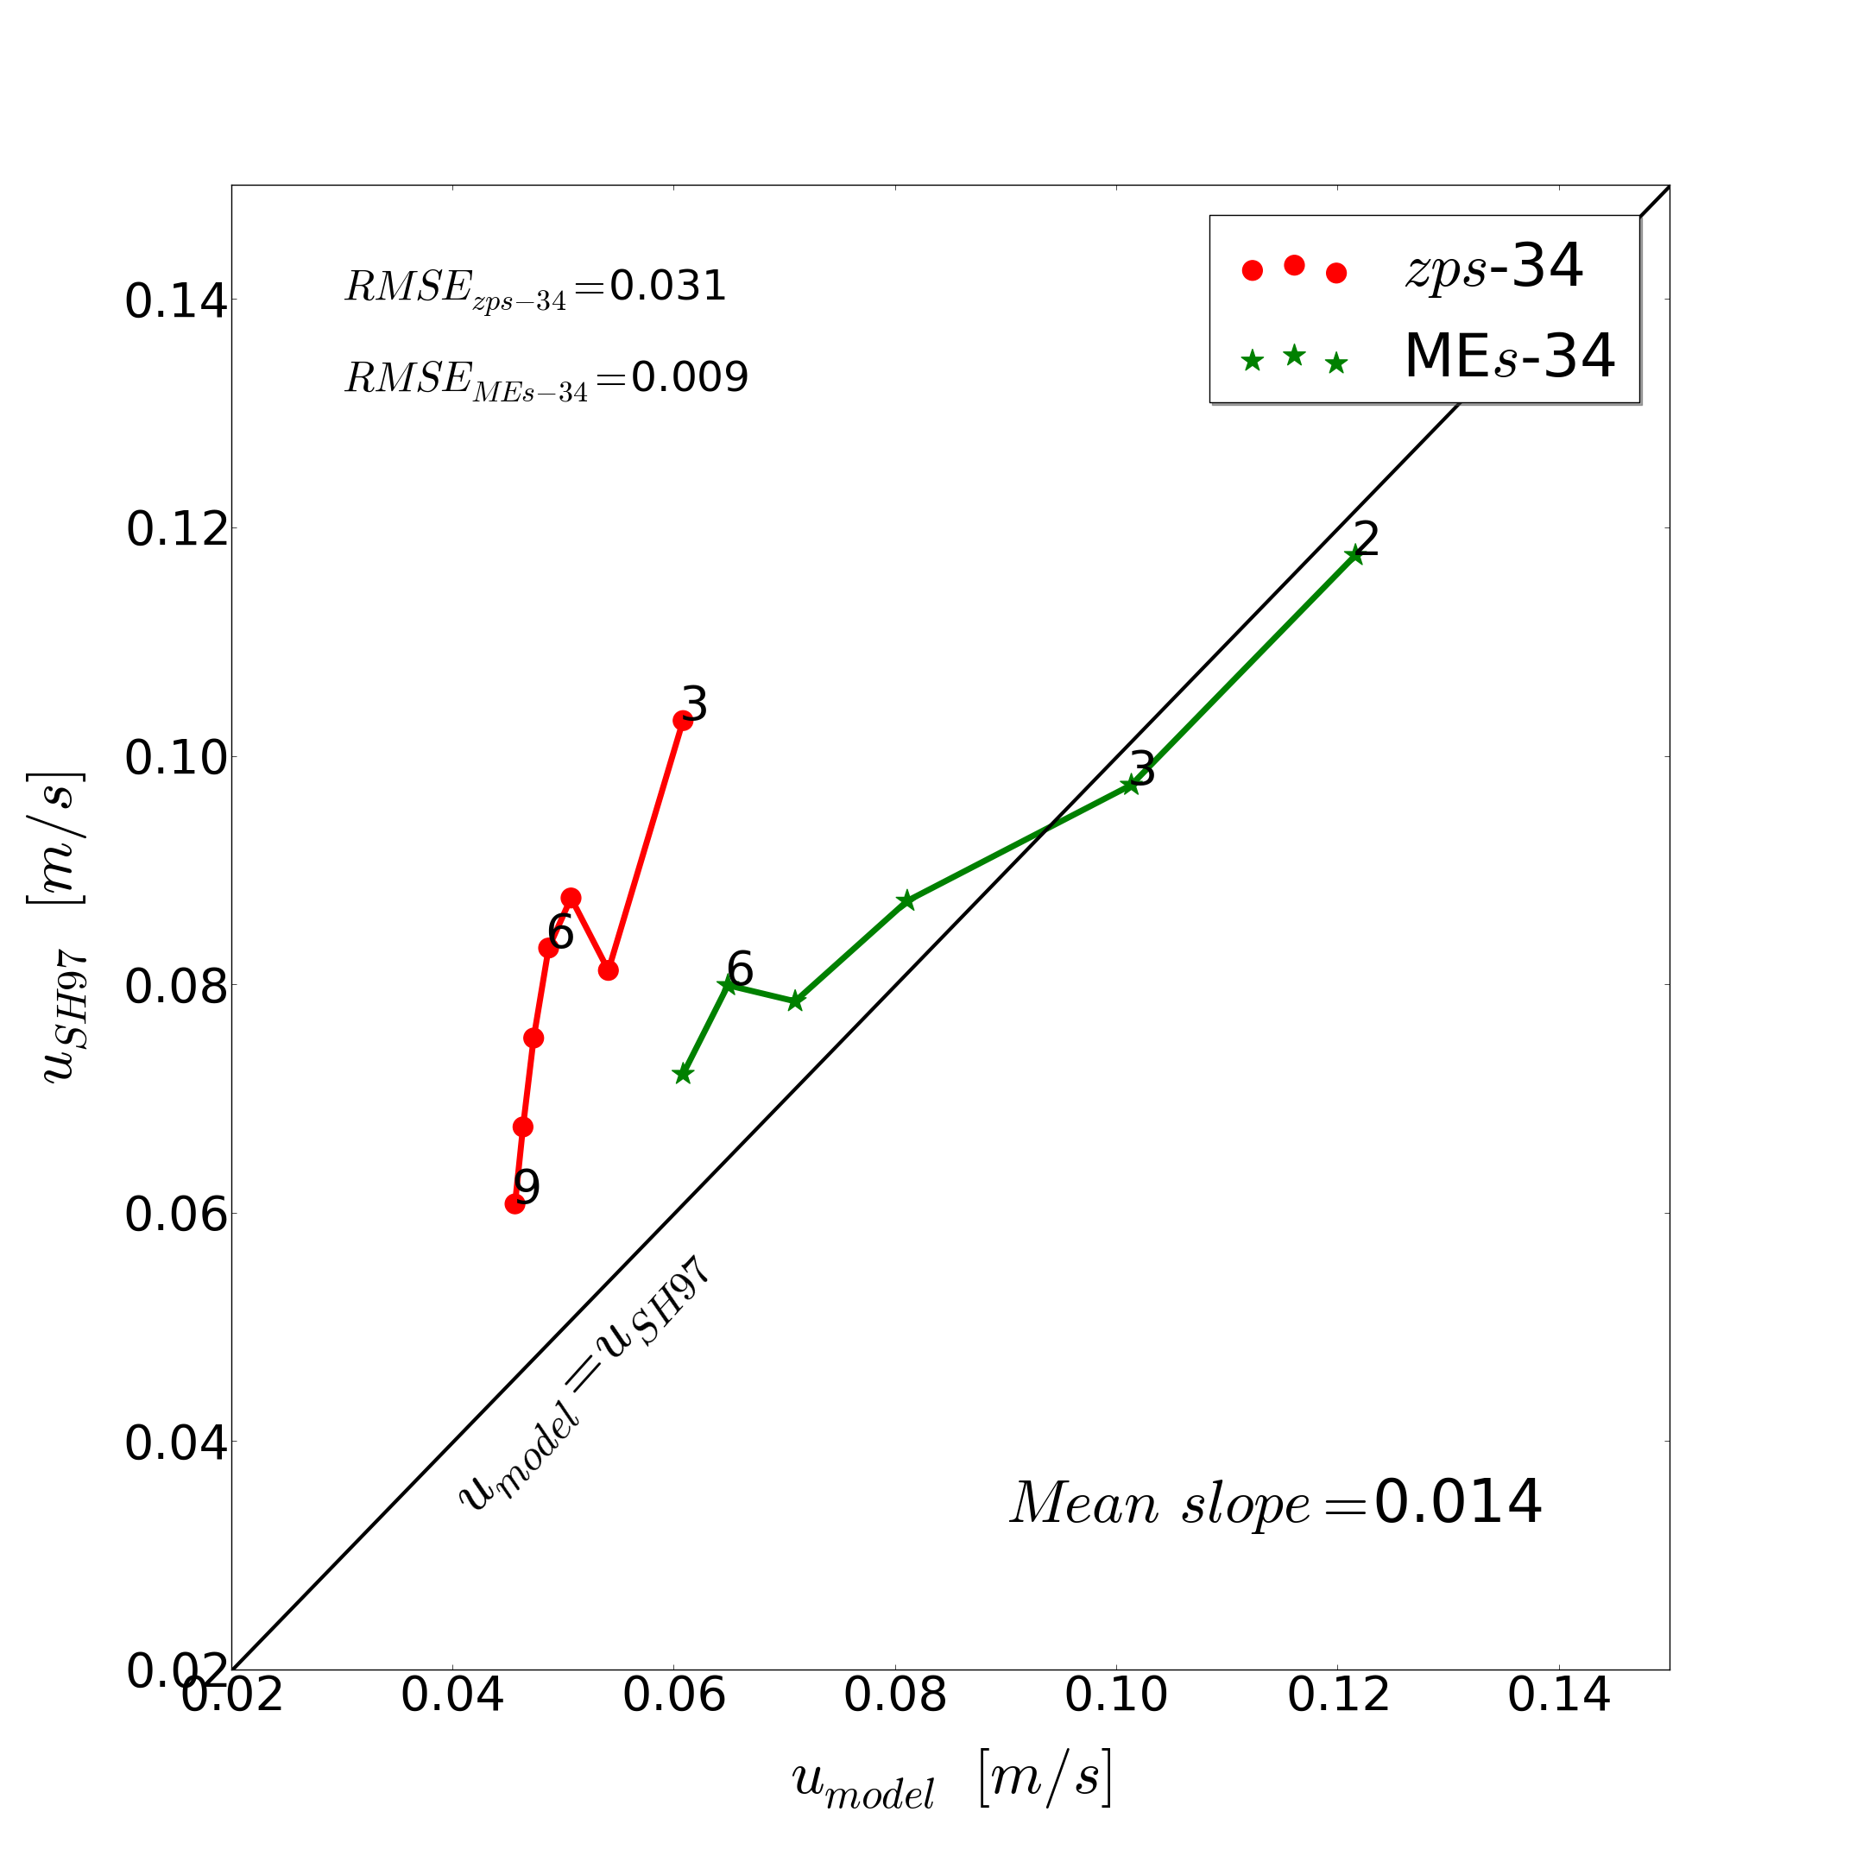
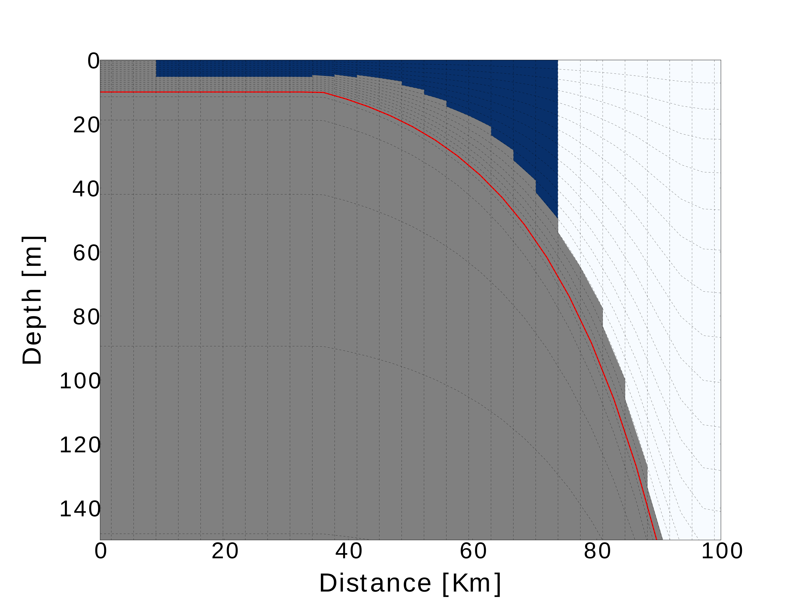
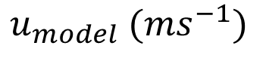
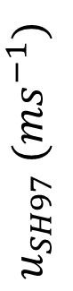
IDEALISED EXPERIMENTS – CASC EXP
OCEAN PROCESS: dense water cascading down a steep topographic slope
INITIAL CONDITION
RESULTS
zps-34
Dense water ring in coastal areas
NO initial currents
NO external forcing
$$u_{SH97} (ms^{−1})$$
Analytical solution for the downslope velocity (Shapiro & Hill 1997) vs downslope velocity from zps-34 and the MEs-34 numerical models.
MEs-34
$$u_{model} (ms^{−1})$$
Notes:
On the right we compare the analytical solution for the downslope velocity given by Shapiro & Hill 1997 with the one from zps-34 and the MEs-34 models.
The solution of MEs-34 is in good agreement with the analytical one, while zps-34 systematically underestimates the reference solution.

Slide 20
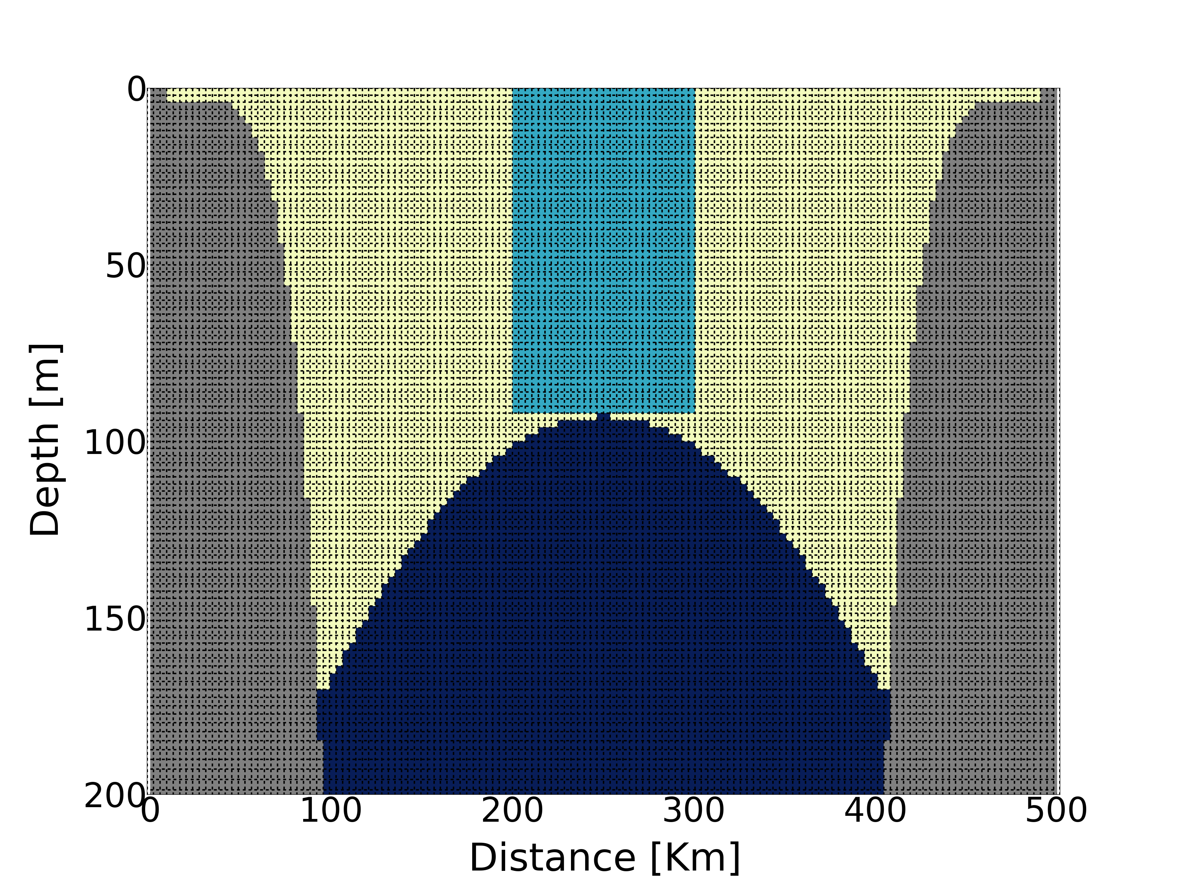
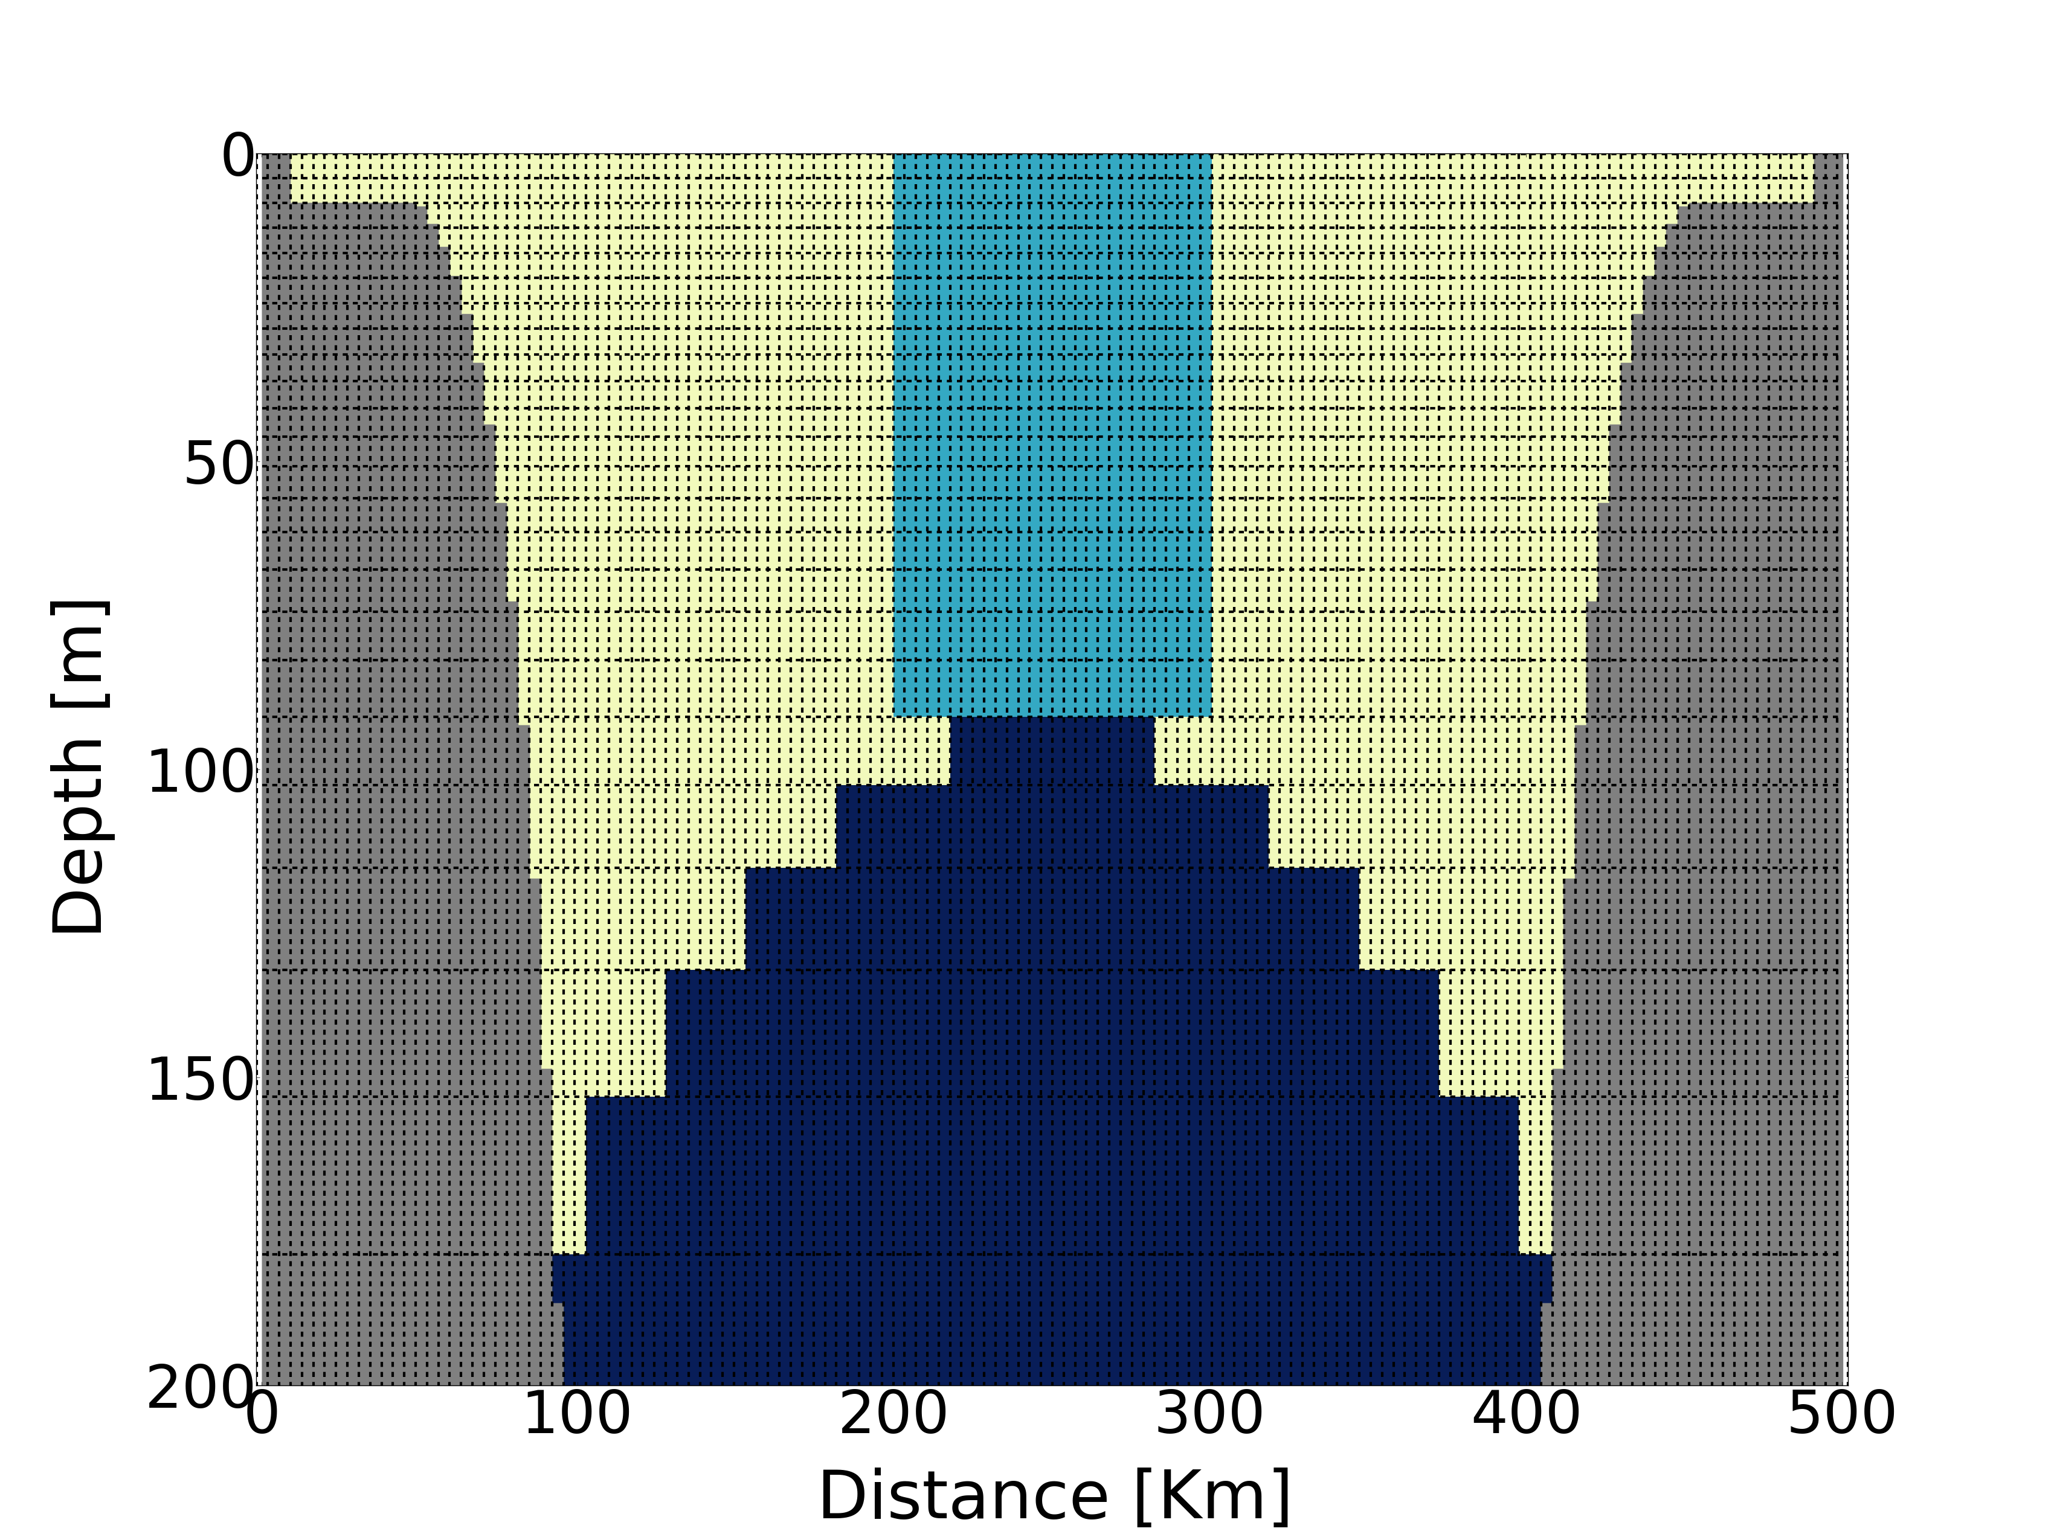
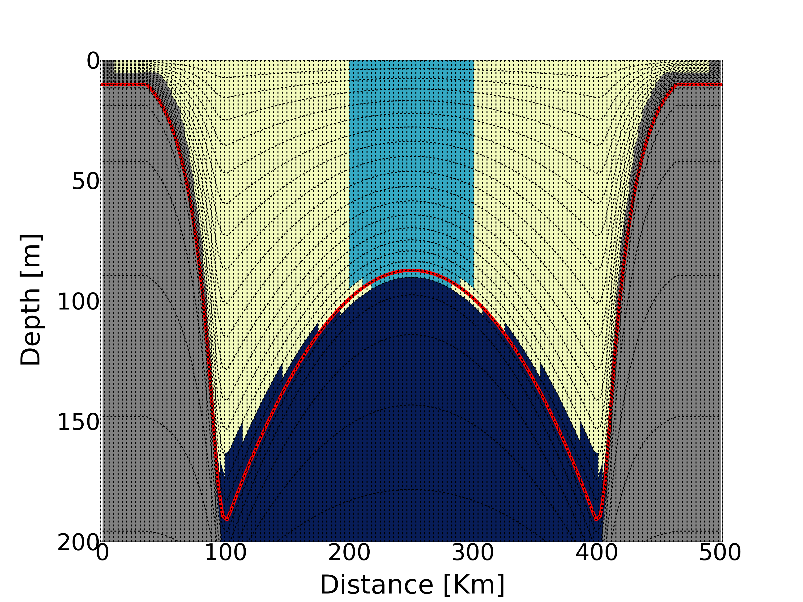

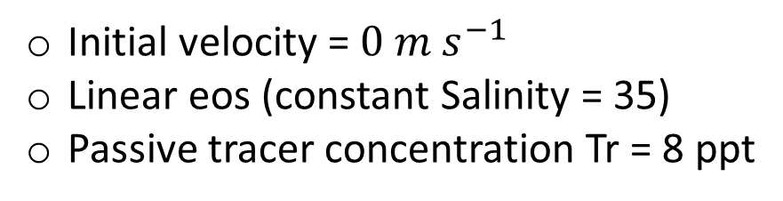
IDEALISED EXPERIMENTS – CILF EXP
OCEAN PROCESS: Sinking and spreading of a dense (cold) patch of water
in an idealised two-layer cyclonic ocean with a doming
pycnocline -> formation of a Cold Intermediate Layer (CIL)
INITIAL CONDITION
T₁ = 26 ºC
T₃ = 16 ºC
Tr = 8 ppt
100 km
93 m
T₂ = 6 ºC
zfs-150
zps-34
MEs-34
150 levels
Standard NEMO-3.6 z with full steps
Initial velocity = $0 m s^{−1}$
Linear eos (constant Salinity = 35)
Passive tracer concentration Tr = 8 ppt
Notes:
To the best of our knowledge, there is no analytical solution for this problem.
So, we compare zps-34 and MEs-34 models against a model named zfs-150 which uses the same horizontal grid but has a very high resolution vertical grid with 150 standard z-levels.
We monitor the evolution of the dense cold water with a passive tracer which has initial concentration of 8 ppt.

Slide 21
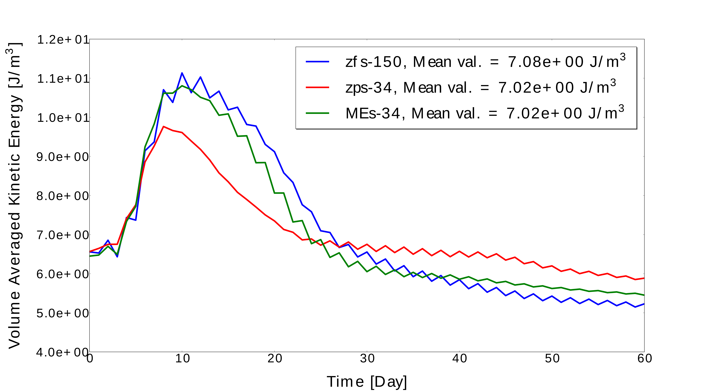
IDEALISED EXPERIMENTS – CILF EXP
RESULTS
CIL NEUTRALLY BUOYANT: GEOSTROPHY IS THE LEADING DYNAMICS
VOL. AVE. KE [J/m³]
CIL SINKING AND SPREADING ALONG THE PYCNOCLINE
TIME [day]
Notes:
Here we show timeseries of the basin averaged KE obtained with the reference zfs-150 model (in blue) and MEs-34 and zps-34 models (in green and red).
As we can see, all the models seem to represent the same general dynamic: a first energetic phase where the CIL is sinking and spreading along the pycnocline and a second phase where CIL is neutrally buoyant and geostrophy is the leading dynamics
We can see that while MEs-34 has a solution very similar to the reference one, zps-34 seem to simulate a less energetic and shorter first phase and a relatively more energetic second phase.

Slide 22
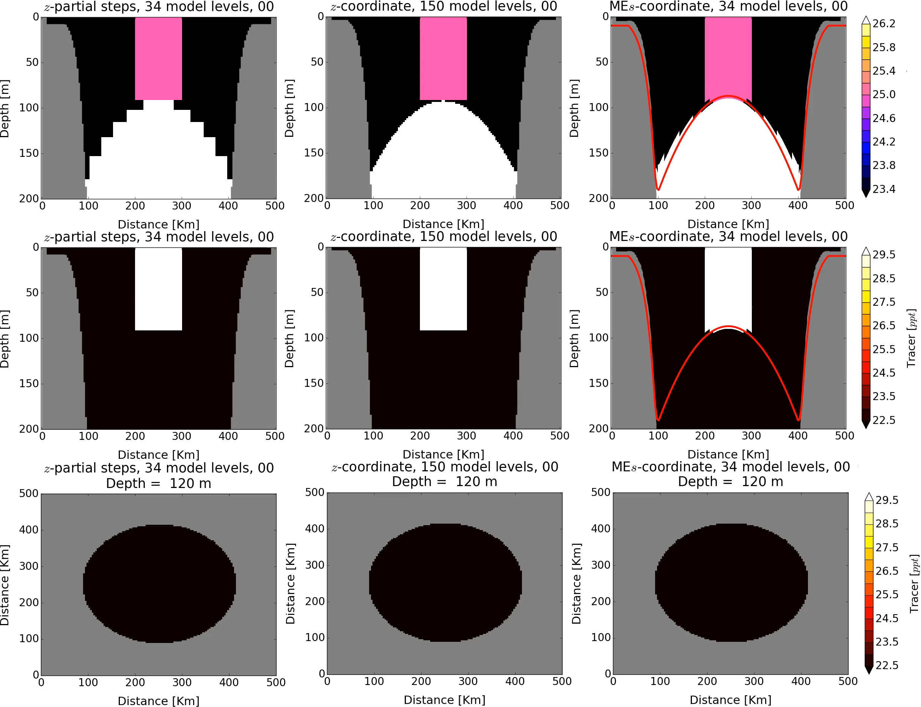
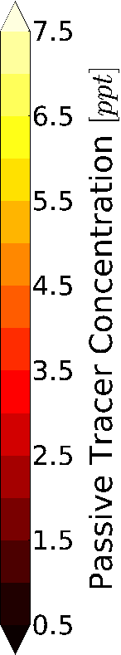
IDEALISED EXPERIMENTS – CILF EXP
zps-34
MEs-34
RESULTS
Density [kg/m³]
Notes:
Here we show a video of the solution obtained with the three models.
The upper row shows cross sections of potential density, while the second and third rows present cross-sections and maps@120m of the passive tracer concentration.
As we can see, MEs-34 simulates a CIL which sinks and spreads along the pycnocline with a dynamic very similar to the one of reference model, while in the zps-34 solution it is evident the impact of the advection-diffusion step-like dynamics which characterises this scheme.
Also, MEs-34 seems to be able to reduce spurious numerical mixing: indeed at the end of the simulation it represents a high-concentration dense ring in geostrophic balance very similar to the one of the zfs-150 model.
On the other hand, as we can see the zps-34 model is unable to represent this high concentration dense ring.

Slide 23
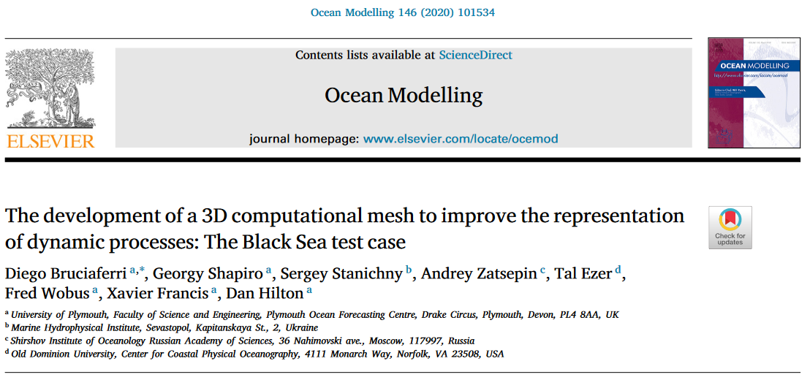
REALISTIC APPLICATIONS – REGIONAL MODELLING
Notes:
In the realistic experiments, we apply the multi-enveloping method to the Black Sea.
If you are interested, you can find the details of this study in this paper.

Slide 24
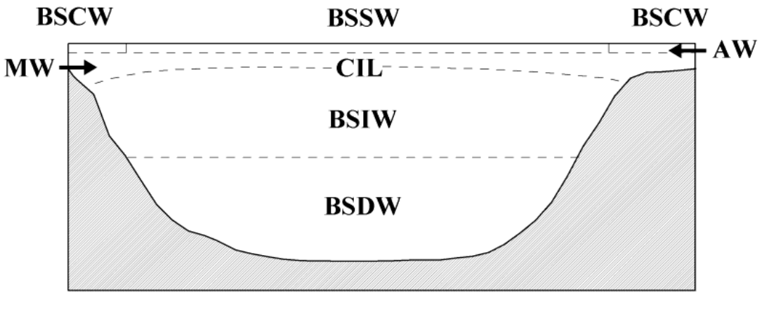
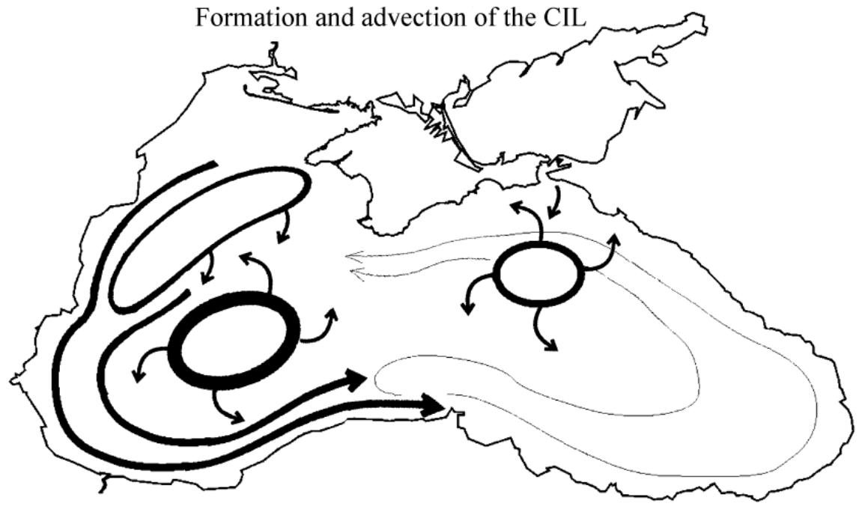
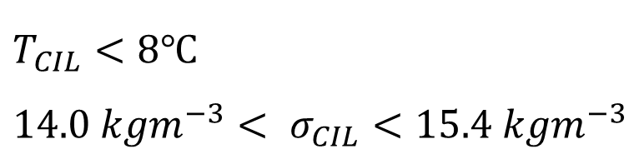
BLACK SEA APPLICATION – SET UP
BLACK SEA MAIN PHYSICAL PROCESSES – THE COLD INTERMADIATE WATER
$$T_{CIL}<8℃$$
$$14.0 kgm^{−3}< σ_{CIL}<15.4 kgm^{−3}$$
Cascading of cold water formed during winter in the NW shelf
Winter convective mixing in the middle of cyclonic gyres.
Notes:
One of the main feature of the Black Sea oceanography is the presence of a sub-surface water mass named Cold Intermediate Water which is characterised by temperature less than 8 degree Celsius and density anomaly between 14 and 15.4 kg/m3.
The CIL originates from cold water cascading during winter from the NW shelf and from Winter convective mixing in the middle of cyclonic gyres and then advected all over the basin.

Slide 25
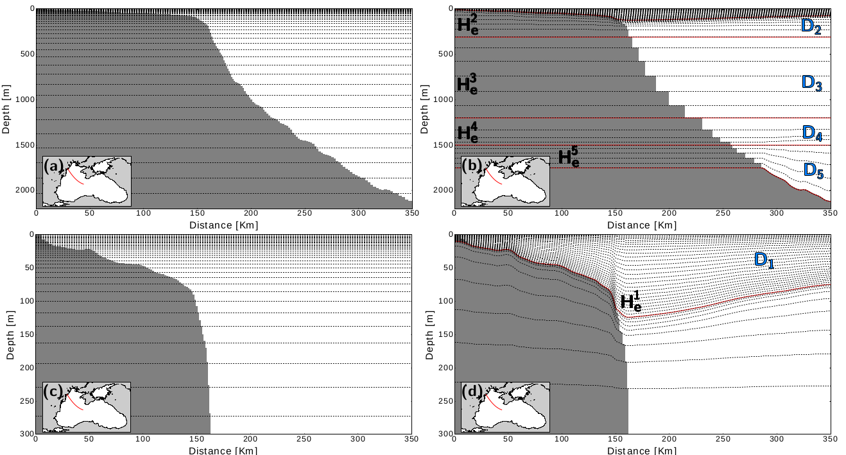
BLACK SEA APPLICATION – VERTICAL GRID
zps MEs (5 envelopes)
Notes:
The two models use two different vertical grids with 51 levels: one adopts the z-partial steps scheme while the other uses the multi enveloping method with 5 envelopes.

Slide 26
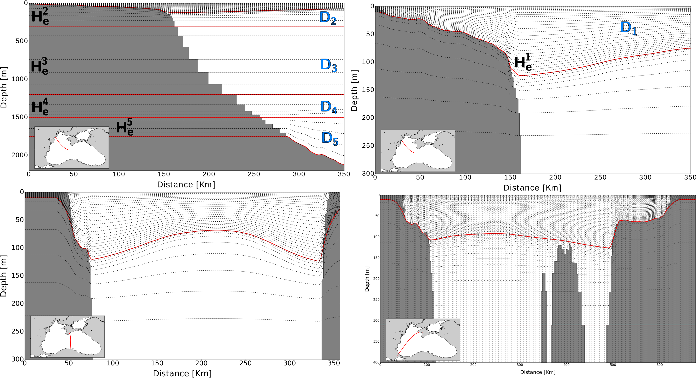
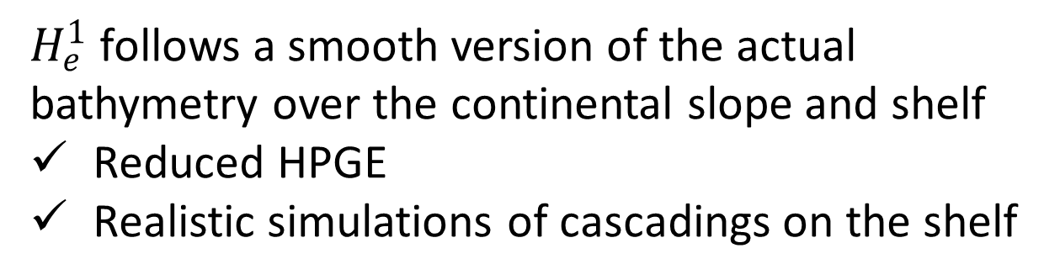
BLACK SEA APPLICATION – VERTICAL GRID
$H_{e}^{1}$follows a smooth version of the actual bathymetry over the continental slope and shelf
Reduced HPGE
Realistic simulations of cascadings on the shelf
Notes:
The upper envelope is designed to follow a smooth version of the actual bathymetry over the continental slope and shelf, allowing to reducing HPGE but still obtaining accurate simulations of cascading on the shelf

Slide 27
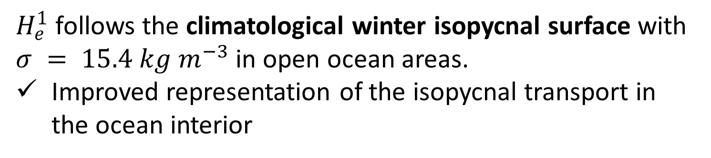
BLACK SEA APPLICATION – VERTICAL GRID
$H_{e}^{1}$follows the climatological winter isopycnal surface with $σ = 15.4 kg m^{−3}$in open ocean areas.
Improved representation of the isopycnal transport in the ocean interior
Notes:
At the same time, the upper envelope follows the climatological winter isopycnal surface with density anomaly$= 15.4 kg m^{−3}$in open ocean areas, which should allow to improve the representation of the isopycnal transport in the ocean interior

Slide 28
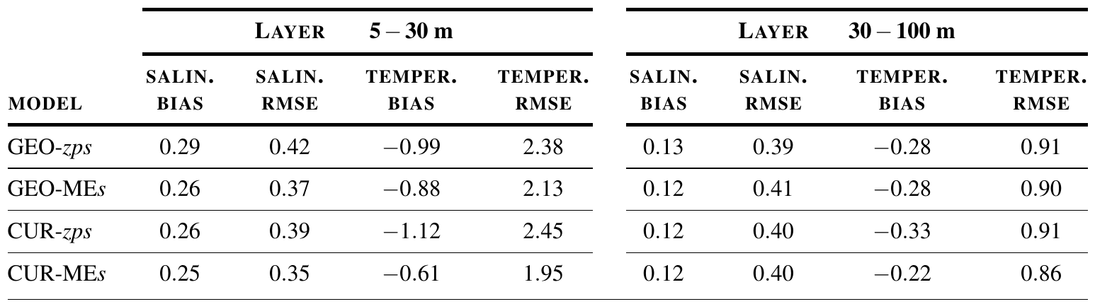
BLACK SEA APPLICATION – RESULTS
Volume averaged 2008 summer-autumn mean BIAS and RMSE computed for 4 specific depth layers in the upper 300 m [Lishaev et al. (2018)]
Models’ skill significantly differ in the active part of the sea
(5-100 m)
CUR-MEs has increased accuracy for T in both sub-surface layers
For S improvements are less notable
Notes:
We continue the analysis computing the basin averaged 2008 summer-autumn mean BIAS and RMSE for the 4 depth layers defined by Lishaev et al. (2018).
Results show that
Models’ skill significantly differ in the active part of the sea (5-100 m)
CUR-MEs has increased accuracy for T in both sub-surface layers
For S improvements are less notable

Slide 29
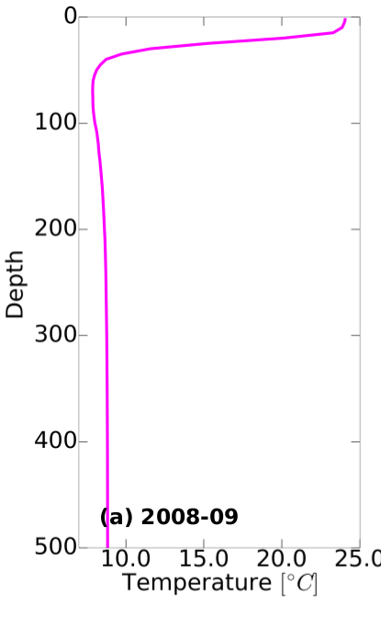
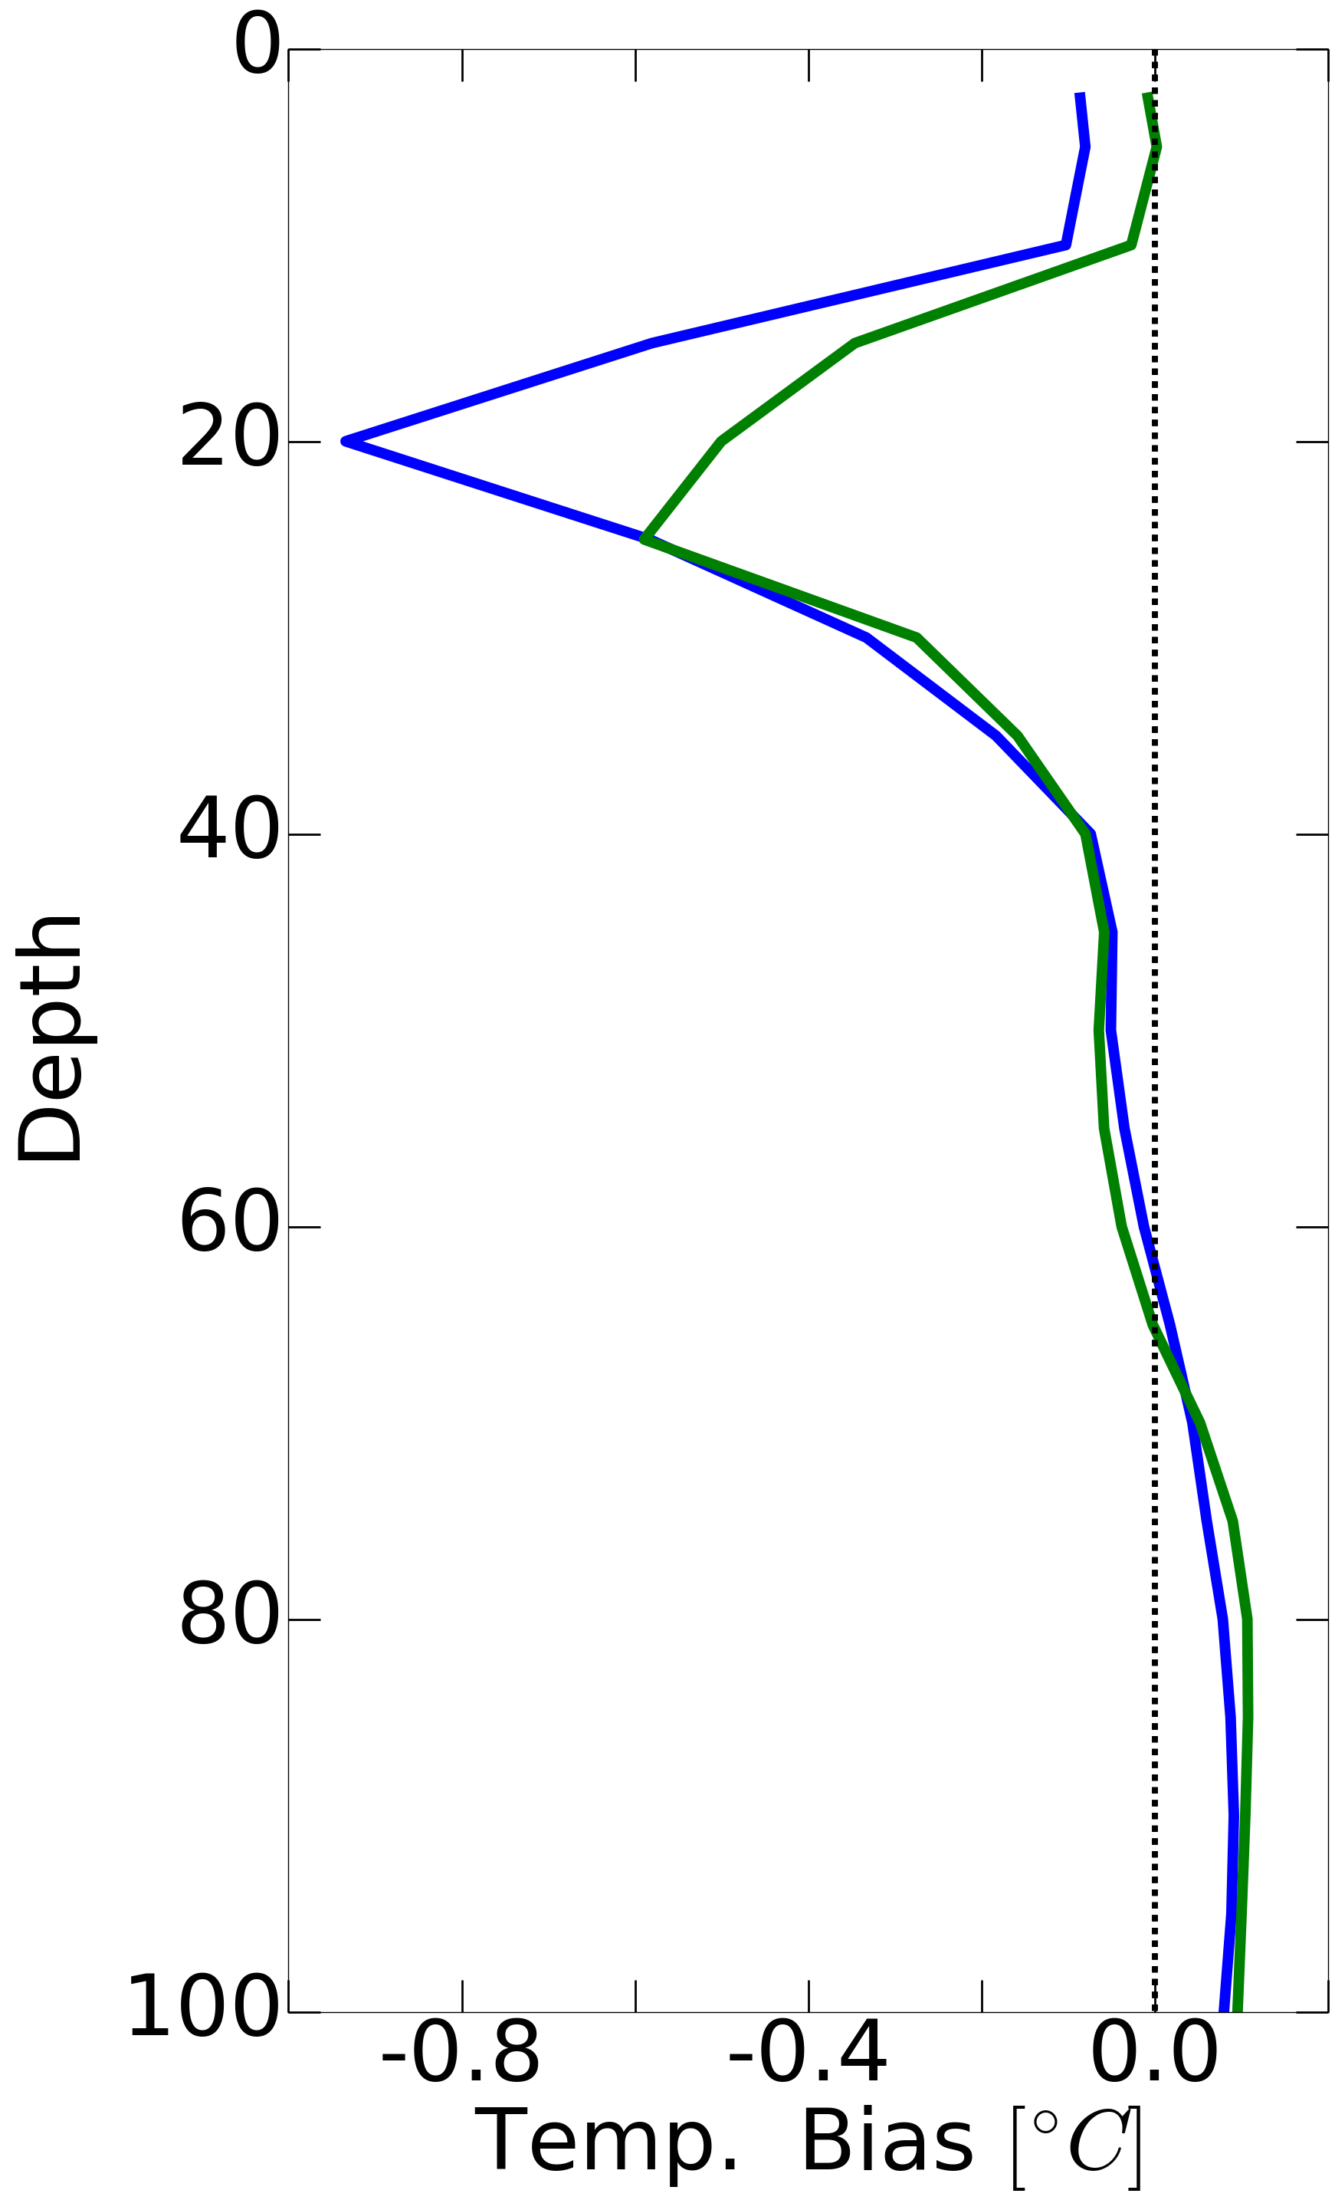
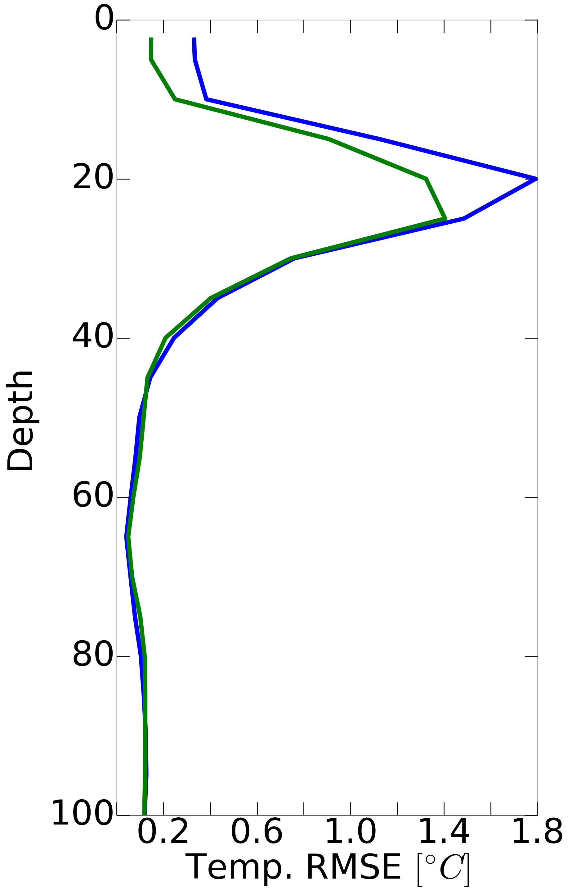
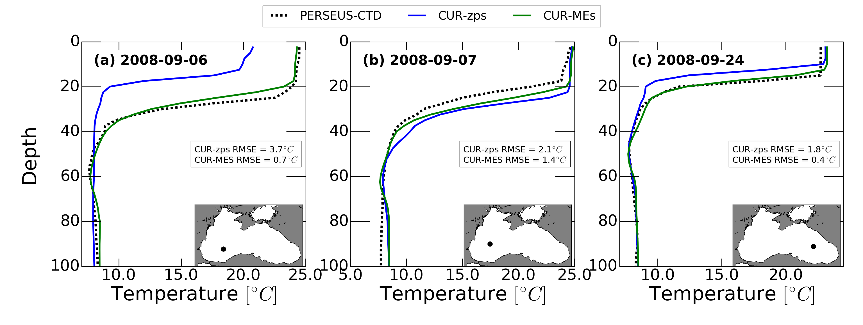
BLACK SEA APPLICATION – RESULTS
OBS.
CUR-zps
CUR-MEs
Within the active layer
MEs has improved accuracy
with respect to zps
Sep. 2008 mean profiles of T BIAS and RMSE
Examples of Sep. 2008
T profiles
Notes:
As we saw in the previous slide, model results significantly differ for T in September 2008. So here we show the basin averaged September 2008 mean BIAS and RMSE profiles for T.
We can clearly see that the CUR-MEs model, in green, has improved accuracy in the active layer of the sea, where the CIL is formed and advected.
To understand better the reason for this, in the bottom panel we show examples of the actual T profiles. As we can see, the MEs grid is able to better capture the feature of the CIL while the zps grid seems to be affected by a too high numerical mixing which tends to erode the CIL structure.

Slide 30
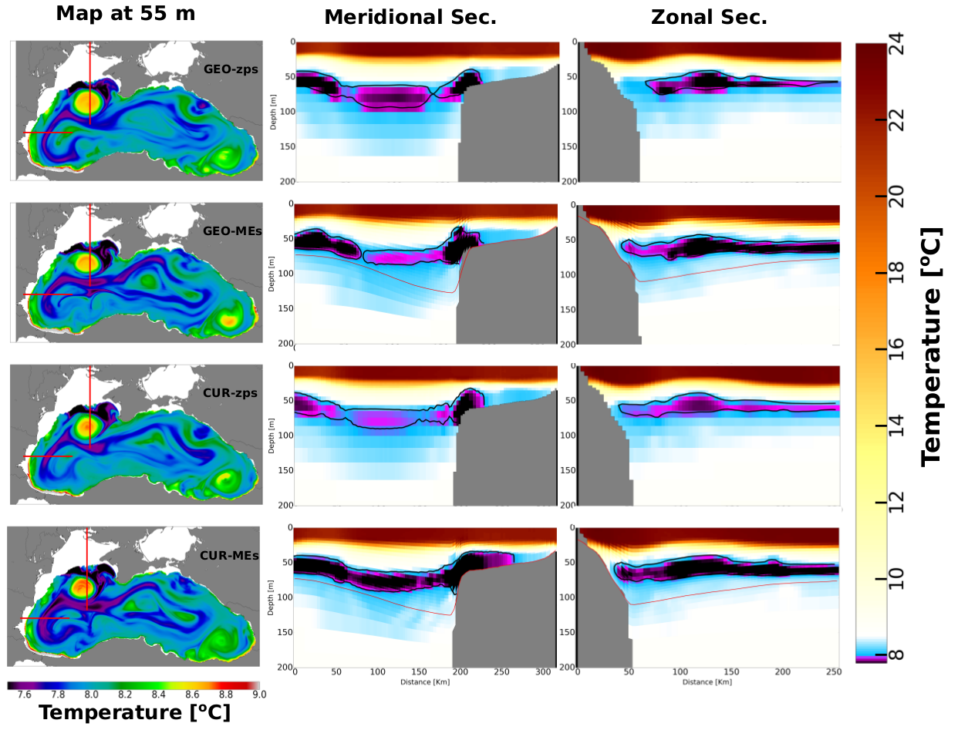
BLACK SEA APPLICATION – RESULTS
September 2008 mean T maps (at 50 m) and cross sections
MAP @ 55 m
MERIDIONAL SEC.
ZONAL SEC.
In coastal areas MEs has
terrain-following levels
higher resolution in the BBL
Cascading is better resolved.
Notes:
Ok, let’s now have a look at the differences between the two models in representing the horizontal structure of temperature distribution.
Here we show in the first column September 2008 averaged maps of T @ 55 m, while in the second and third column we present T zonal and meridional cross-sections extracted in the locations identified with a red line in the maps.
At first, we can note that the CIL simulated by the model using the MEs scheme is generally colder and has larger spatial extension than the one represented by the zps model.
Then, we can see that both models represent cascading of dense water on the shelf, although the one of the MEs model seems to be deeper and less diffusive than the one reproduced with a zps grid. This is probably due to the fact that MEs grid has terrain-following levels and higher resolution in the BBL in coastal areas.

Slide 31
BLACK SEA APPLICATION – RESULTS
September 2008 mean T maps (at 50 m) and cross sections
MAP @ 55 m
MERIDIONAL SEC.
ZONAL SEC.
In coastal areas MEs has
terrain-following levels
higher resolution in the BBL
Cascading is better resolved.
In open ocean areas MEs has
nearly isopycnal levels
increased vertical resolution in the active layer of the sea
Reduced spurious numerical diapycnal mixing and improved simulation of the CIL dynamics
Notes:
Also we can see that the CUR-MEs model simulates an almost homogeneous CIL with 𝑇≤7.6◦C extending from the shelf to the off-shore area.
While the zps model represent a CIL less homogeneous and warmer.
This is probably due to the fact that MEs has nearly isopycnal levels and increased vertical resolution in the active layer of the sea, allowing to reduce spurious numerical mixing.

Slide 32
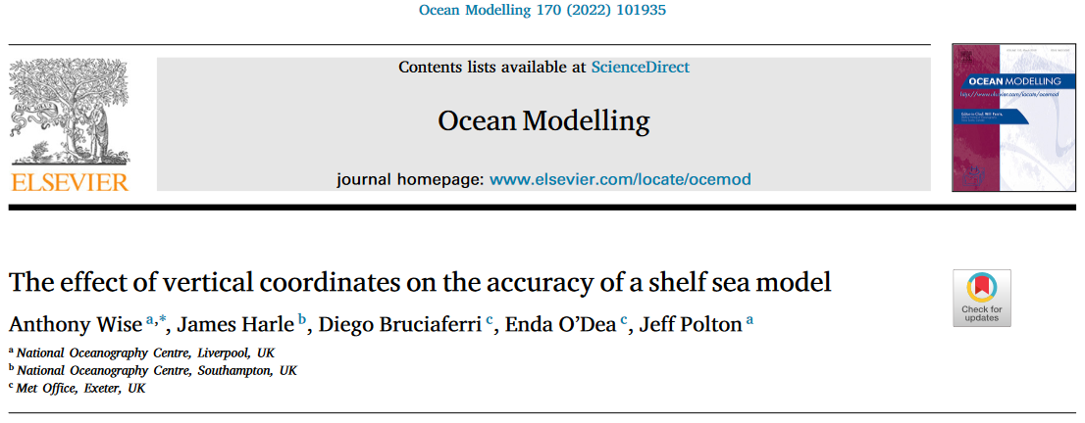
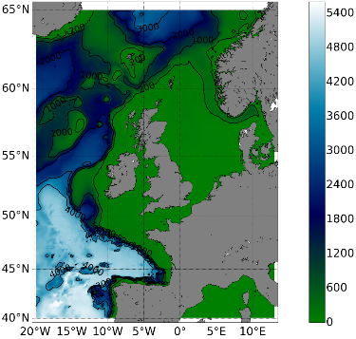
REALISTIC APPLICATIONS – REGIONAL MODELLING
Notes:
In the realistic experiments, we apply the multi-enveloping method to the Black Sea.
If you are interested, you can find the details of this study in this paper.

Slide 33
MET OFFICE AMM7 MODEL - MOTIVATION
The choice of the vertical coordinate system importantly affects the quality of ocean model simulations. For example:
Truncation errors specific to the chosen vertical coordinate system may introduce errors in the pressure gradient computation, generating spurious current velocities.
The type of vertical coordinate system dictates the way an ocean model represents the bottom topography and the bottom boundary layer dynamics, importantly affecting processes as tides or dense water cascading on the shelf.
Aim of the study:
Assess the impact of different vertical coordinate systems on the accuracy of the solution of a free-running NEMO4.0.4 NWS ocean model.
Notes:
In the realistic experiments, we apply the multi-enveloping method to the Black Sea.
If you are interested, you can find the details of this study in this paper.

Slide 34
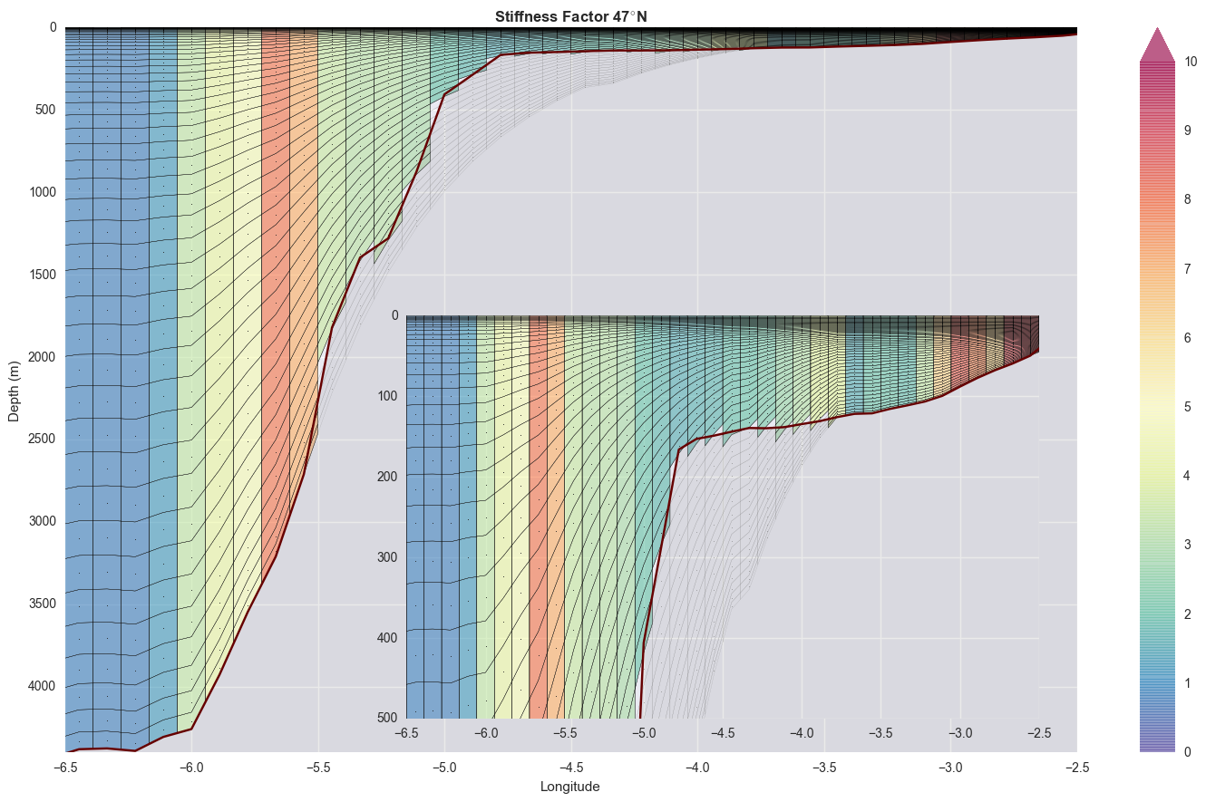
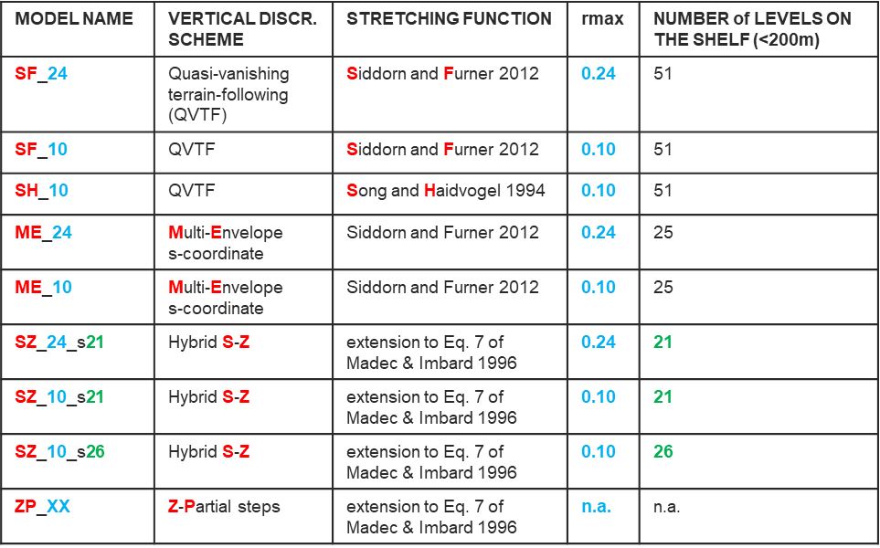
MET OFFICE AMM7 MODEL – EXPERIMENTAL SETUP
Nine models of the NWS differing only in the vertical discretization schemes are tested
Notes:
In the realistic experiments, we apply the multi-enveloping method to the Black Sea.
If you are interested, you can find the details of this study in this paper.

Slide 35
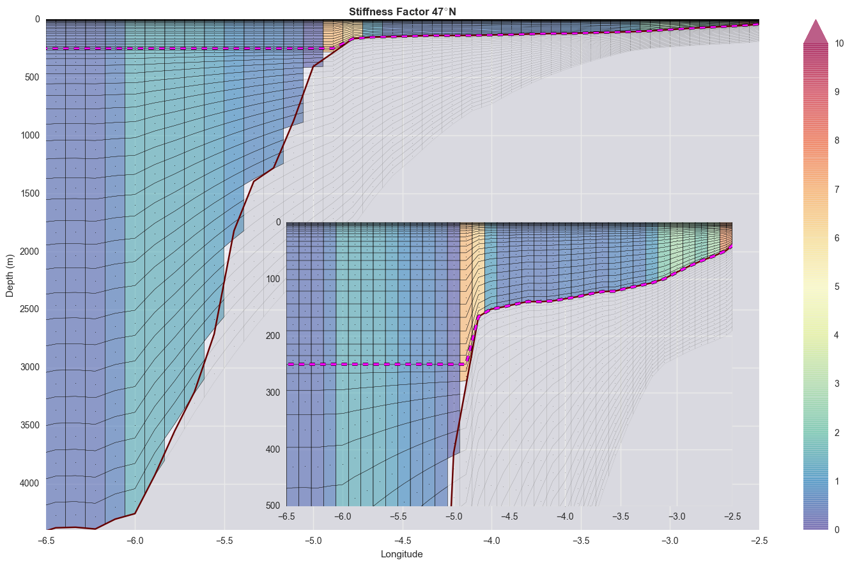
MET OFFICE AMM7 MODEL – EXPERIMENTAL SETUP
Nine models of the NWS differing only in the vertical discretization schemes are tested
Notes:
In the realistic experiments, we apply the multi-enveloping method to the Black Sea.
If you are interested, you can find the details of this study in this paper.

Slide 36
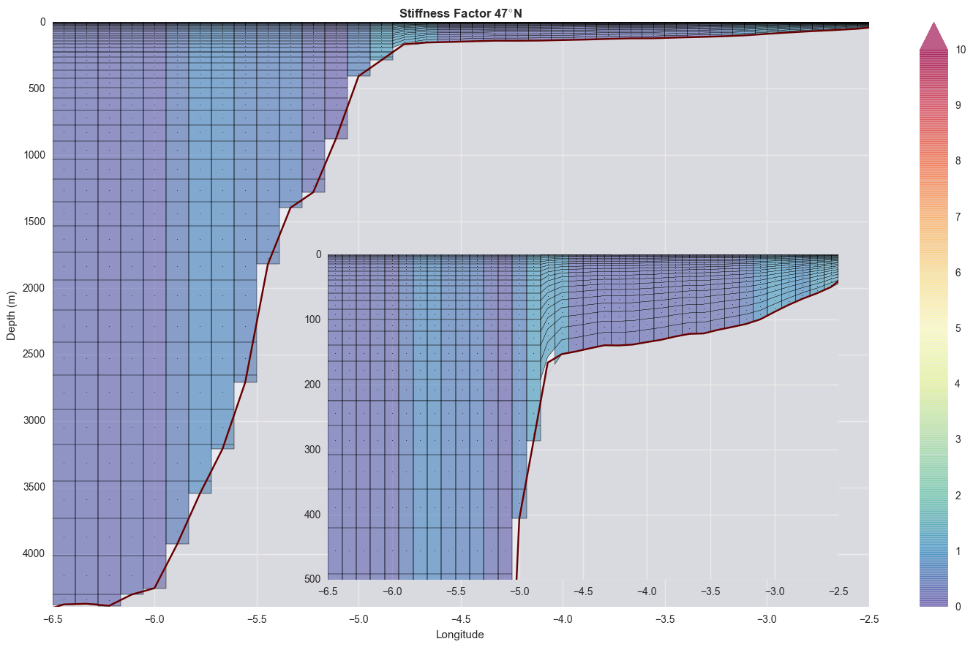
MET OFFICE AMM7 MODEL – EXPERIMENTAL SETUP
Nine models of the NWS differing only in the vertical discretization schemes are tested
Notes:
In the realistic experiments, we apply the multi-enveloping method to the Black Sea.
If you are interested, you can find the details of this study in this paper.

Slide 37
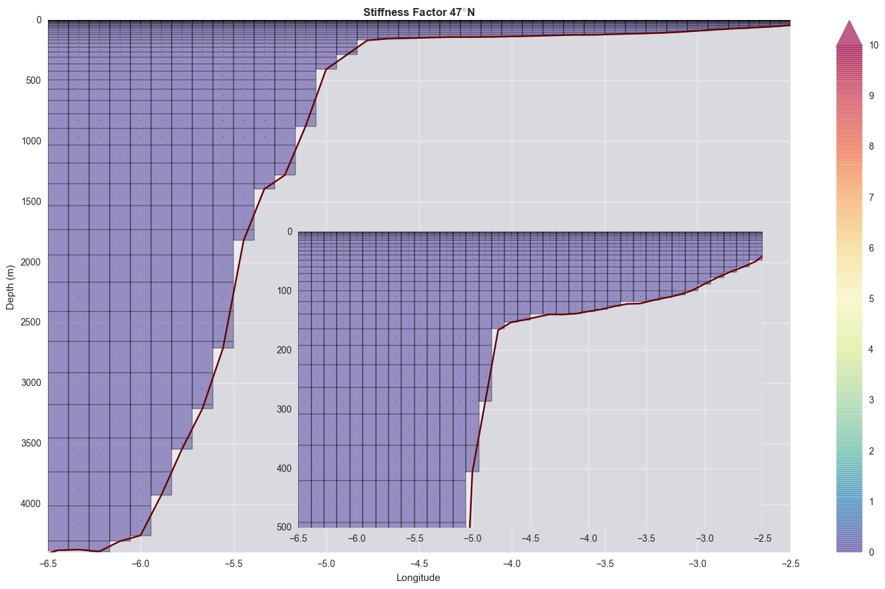
MET OFFICE AMM7 MODEL – EXPERIMENTAL SETUP
Nine models of the NWS differing only in the vertical discretization schemes are tested
Notes:
In the realistic experiments, we apply the multi-enveloping method to the Black Sea.
If you are interested, you can find the details of this study in this paper.

Slide 38
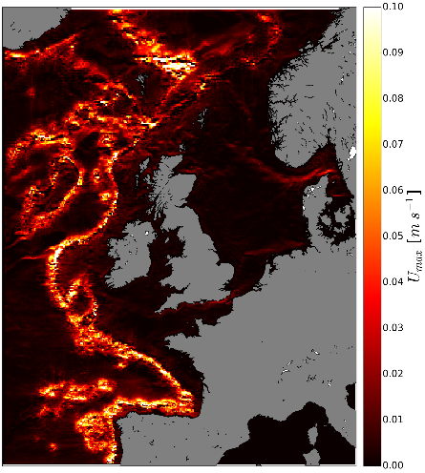
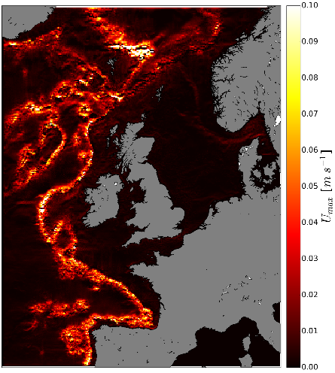
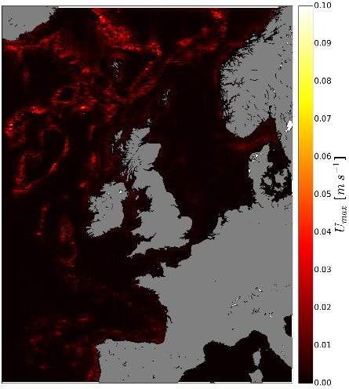
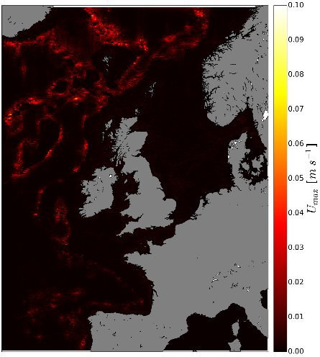
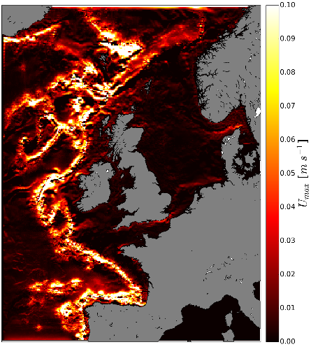




MET OFFICE AMM7 MODEL – NUMERICAL EXPERIMENTS
1) Horizontal Pressure Gradient Errors (HPGE) experiment
Initial stratification such that
no initial Horizontal Pressure Gradients (HPG)
no initial circulation
No external forcing
Assessment against analytical solution: in the absence of diffusion, the solution for current velocities and horizontal density gradients is zero.
Maps of daily averaged maximum (in the vertical) spurious currents after 30 days
RESULTS: HPGE
CURRENTLY OPERATIONAL MODEL
SF_10
SH_10
ME_24
ME_10
SF_24
s-like models
z-like models
SZ_24_s21
SZ_10_s21
SZ_10_s26
ZP_XX
Notes:
In the realistic experiments, we apply the multi-enveloping method to the Black Sea.
If you are interested, you can find the details of this study in this paper.

Slide 39

MET OFFICE AMM7 MODEL – NUMERICAL EXPERIMENTS
2) Climatological stratification (CLIM) experiment
2005-2015 run using realistic initial stratification, forcing (atmospheric, river, bdy)
Assessment: comparison against T/S EN4 monthly profiles
Overall:
Traditional VQS models (SF_24, SF_10 and SH_10) have the largest errors and std
Hybrid coordinate systems (SZ_*, ME_*) and traditional z-partial steps levels (ZP_XX) have improved accuracy wrt VQS schemes
ME_* have the smallest mean absolute error and the smallest std.
Notes:
In the realistic experiments, we apply the multi-enveloping method to the Black Sea.
If you are interested, you can find the details of this study in this paper.

Slide 40
REALISTIC APPLICATIONS – GLOBAL MODELLING
Improving Nordic overflows representation in global ocean models
D. Bruciaferri¹, C. Guiavarc’h¹, H. Hewitt¹, J. Harle², M. Almansi², P. Mathiot³
¹ Met Office Hadley Centre, Exeter, UK
² National Oceanography Centre, Southampton, UK
³ Université Grenoble Alpes, Grenoble, France
IN PREPARATION
Notes:
In the realistic experiments, we apply the multi-enveloping method to the Black Sea.
If you are interested, you can find the details of this study in this paper.

Slide 41

NORDIC OVERFLOWS – MOTIVATIONS
The Nordic Overflows generate water-masses with specific hydrographic features, forming the lower limb of the Atlantic Meridional Overturning Circulation (AMOC) and therefore significantly affecting the global climate.
Notes:
In the realistic experiments, we apply the multi-enveloping method to the Black Sea.
If you are interested, you can find the details of this study in this paper.

Slide 42
NORDIC OVERFLOWS – MOTIVATIONS
Gravity currents representation in ocean models is sensitive to the choice of the vertical coordinates system:
Geopotential z-coordinates: bottom topography represented as a series of step-like structures -> too much spurious entrainment and mixing (e.g., Legg et al. 2006).
Terrain-following coordinates: natural representation of overflows but errors in the computation of the pressure-gradient force -> their use in global configurations is challenging (e.g., Lemarié et al. 2012).
Arbitrary-Lagrangian-Eulerian (ALE) coordinates: can significantly reduce spurious mixing in the ocean interior but might introduce too large dilution in some regions where overflows occur (e.g. Adcroft et al. 2019) -> they might be not the best solution for overflows
Notes:
In the realistic experiments, we apply the multi-enveloping method to the Black Sea.
If you are interested, you can find the details of this study in this paper.

Slide 43
NORDIC OVERFLOWS – AIM OF THE STUDY
Can we develop a GENERALISED vertical coordinate system that LOCALLY employs OPTIMISED terrain-following computational surfaces while GLOBALLY uses geopotential z-levels with partial steps?
GENERALISED: as a study-case, it will be configured and tested for the Nordic overflows but should be easily applicable wherever we want.
OPTIMISED: locally terrain-following levels should have low associated HPG errors but still able to offer a realistic representation of the bottom topography
Notes:
In the realistic experiments, we apply the multi-enveloping method to the Black Sea.
If you are interested, you can find the details of this study in this paper.

Slide 44



NORDIC OVERFLOWS – LOCALISED ME COORDINATES
GENERALISED ALGORITHM to define:
Localisation area: the model uses quasi terrain-following levels.
Global area: the model uses zps levels.
Transition area: model levels as a linear combination of terrain-following and zps levels
2800m isobath
MEs
In the localisation area we implement ME s-levels. Our configuration uses 4 envelopes -> quasi terrain-following levels up to 2800m
MEs-to-zps
zps
Notes:
In the realistic experiments, we apply the multi-enveloping method to the Black Sea.
If you are interested, you can find the details of this study in this paper.

Slide 45







NORDIC OVERFLOWS – IDEALISED OVERFLOW
PASSIVE TRACER CONC. AFTER 40 DAYS
zps
@bottom
MEs
@bottom
Initial condition:
ocean at rest with 3D uniform initial temperature (T=6 °C) and salinity (S=0) ;
Cold (T=1.5 °C, S=10) water mass in an artificial reservoir;
EOS: linear function of only T -> S is a passive tracer;
zps: largest entrainment and mixing.
Local-MEs: able to significantly reduce passive tracer dilution during the whole simulation, retaining up to 50-60 % of the initial concentration down to ~3000 m after 40 days
Notes:
In the realistic experiments, we apply the multi-enveloping method to the Black Sea.
If you are interested, you can find the details of this study in this paper.

Slide 46


NORDIC OVERFLOWS – REALISTIC EXPERIMENT
Kögur OVIDE
Látrabjarg EEL
OSNAP East Hansen & Osterhus 2000
Notes:
In the realistic experiments, we apply the multi-enveloping method to the Black Sea.
If you are interested, you can find the details of this study in this paper.

Slide 47




NORDIC OVERFLOWS – REALISTIC EXPERIMENT
zps
DJF 2014-2018
OSNAP
DJF 2014-2016
Local-MEs
DJF 2014-2018
Notes:
In the realistic experiments, we apply the multi-enveloping method to the Black Sea.
If you are interested, you can find the details of this study in this paper.

Slide 48




FUTURE DEVELOPMENT – Multi-Envelope NEMO-Nordic
NORDIC-MEs
WORK IN PROGRESS stay tuned!
NORDIC-zps
from Hordoir et al. 2019
Notes:
In the realistic experiments, we apply the multi-enveloping method to the Black Sea.
If you are interested, you can find the details of this study in this paper.

Slide 49




HPG ERRORS: WHERE DO THEY COME FROM?
$$∇_{z}p=∇_{s}p+ ρg∇_{s}z$$
Considering the geostrophic balance
$$f\left(\hat{k}×\vec{u}\right)=ρ_{0}^{−1}∇_{z}p$$
with ocean currents $\vec{u}$ of ${10}^{−1}/{10}^{−2} ms^{−1}$ and mid latitudes (${f=10}^{−4} s^{−1}$), then the HPG along surfaces of constant depth z ($∇_{z}p$) ranges between ${10}^{−3}$ and ${10}^{−2} Nm^{−3}$.
The slope of terrain-following s-levels ($∇_{s}z$) can reach ${10}^{−1} / {10}^{−2}$, especially next to the continental shelves, making this term of the order of ${10}^{3} −{10}^{2}$ $Nm^{−3}$
In s-coordinates the horizontal pressure force $∇_{z}p$ becomes the result of two large sizeable terms (i.e., $∇_{s}p$ and $ρg∇_{s}z$ ), each one having separate numerical errors that generally do not cancel
Notes:
In the realistic experiments, we apply the multi-enveloping method to the Black Sea.
If you are interested, you can find the details of this study in this paper.

